Slide 1
The 8th Uganda Evaluation Week
Uganda Management Institute
August 2 0 2 4
Insights into IPA and the LMIC Researcher Diversification Strategy
Nelson Mandela Acire – Senior Research and Policy Associate

Slide 2
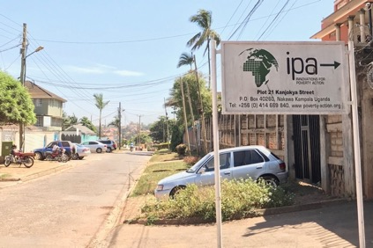
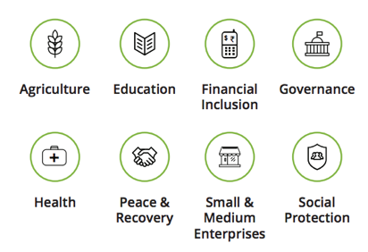
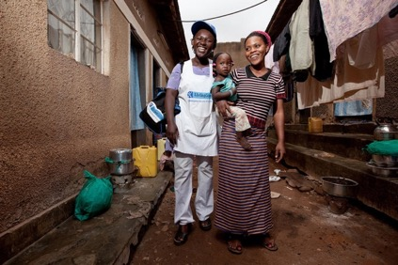
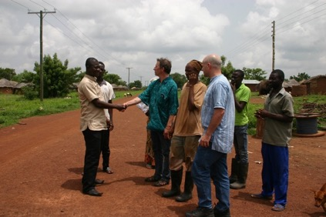
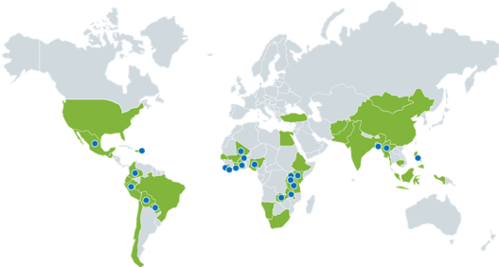
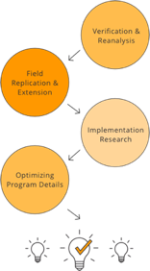
IPA at a Glance
I N T R O D U C T I O N
20 country offices
8 program areas
700+ partners
600+ researchers in our network
900 evaluations to date, in
51 countries
20 plus years of generating evidence and moving evidence to policy
Notes:
Innovations for Poverty Action (IPA) strives to build a world with more evidence and less poverty. IPA bridges the gap between research and policy to build cultures of organizational learning, equip governments to leverage data and evidence through our embedded labs, and supports organizations to make learning-oriented monitoring and evaluation a reality.
We work with donors, researchers, and implementers to diagnose pressing challenges and opportunities for learning, identify and answer key questions, generate new evidence, strengthen research capacity and infrastructure, and apply evidence to inform policy and practice.
Through our diverse and extensive capabilities, IPA offers a research and learning partnership that can be tailored to meet different organizational and learning needs. By leveraging existing knowledge on international development evidence, policy and practice, as well as in monitoring, evaluation, and learning, IPA is strongly positioned to support our partners to participate in the evidence ecosystem.

Slide 3
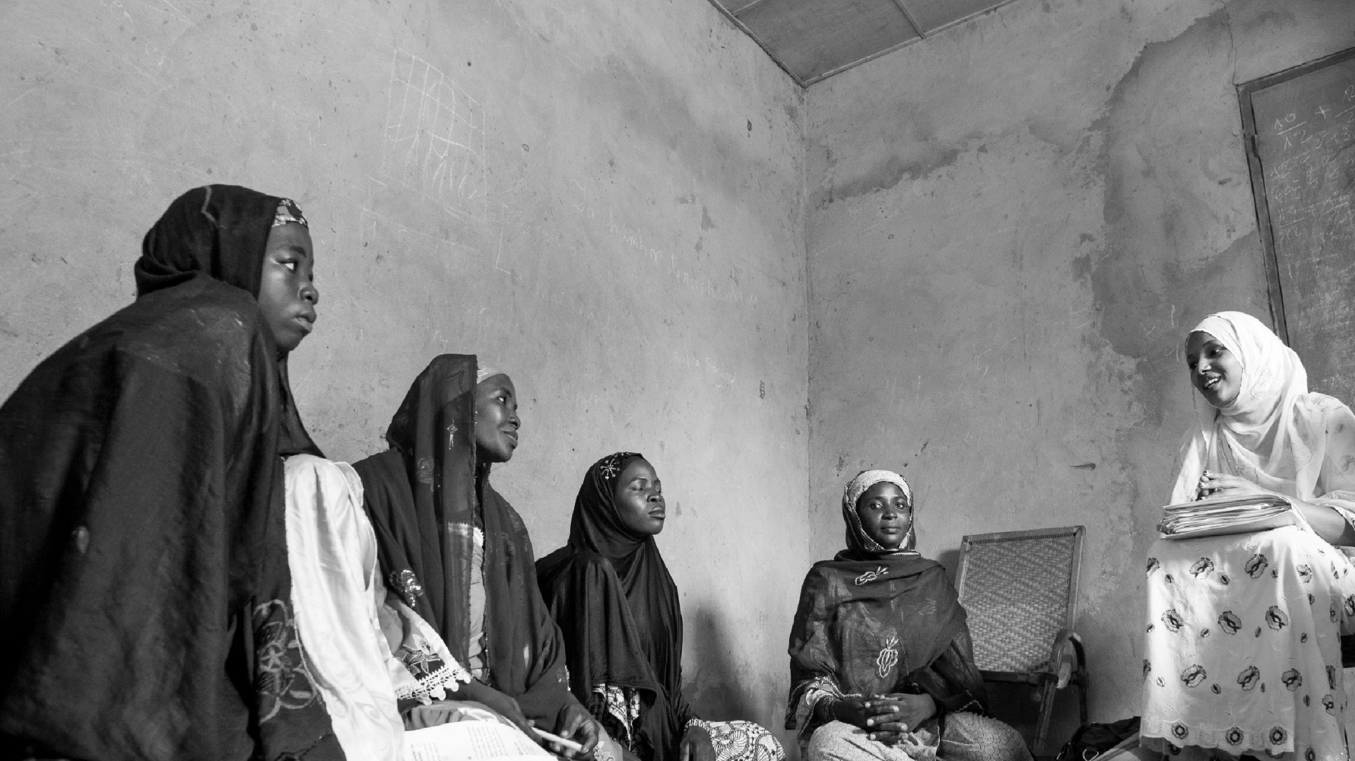

Our Mission
We discover and advance what works to improve the lives of people living in poverty.

Slide 4
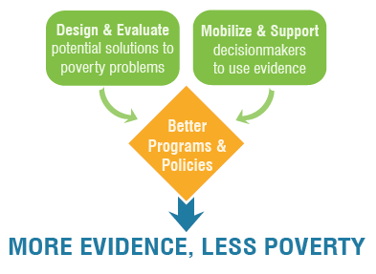
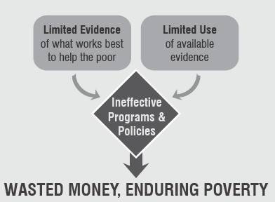
The Problem vs. Solution
S E C T I O N 1 : I N T R O D U C T I O N

Slide 5



What We Do: 3-Pillar Strategy
S E C T I O N 1 : I N T R O D U C T I O N
1. Create Stronger Evidence
To deepen knowledge of how to reduce poverty
2. Share Evidence Strategically
To influence conversations
and inform decisions
3. Equip Decision-Makers to Use Evidence
  To improve the lives
  of the global poor
Notes:
Innovations for Poverty Action (IPA) is an international non-profit organization founded in 2002 that discovers and promotes effective solutions to global poverty problems.
IPA works across three pillars to help reduce global poverty through evidence.
With a network of partners and researchers, we design and test innovative solutions, support our partners to generate and use data and evidence, and help bring proven approaches to scale across the globe.
IPA’s core competence is the successful design and implementation of impact evaluation studies to measure the effectiveness of programs and policies aimed at helping the poor.
To achieve this purpose, IPA uses the most rigorous methodologies; we specialize in randomized controlled trials (RCTs), considered the gold standard of impact evaluation design.
However, we have a much larger toolkit of quantitative and qualitative research approaches and partner and policy engagement strategies.
In IPA, we believe that the involvement of policymakers is significant in increasing the chance of utilizing evidence. Projects implemented in partnership with policymakers are 17 to 20 percentage points more likely to lead to evidence uptake, e.g., intervention scale up, adoption of data management system (Bonargent, 2023).

Slide 6
What We Do
WHAT WE DO
We conduct research
To understand which development interventions work, which do not, and why
We provide sectoral expertise
To identify evidence gaps, support the implementation of research and programs, and promote the use of evidence in our fields of expertise
We equip partners to use evidence
Through the creation of Embedded Evidence Labs and other activities to institutionalize the use of evidence based decision making
We provide research quality control
To ensure that research is high quality and ethical
We provide advisory services
Through our Right-Fit Evidence unit, we provide technical expertise in monitoring, evaluation, and learning (MEL)
We scale what works
We identify, advance, and support promising evidence-based programs to reach impact on a larger scale
We fund research and researchers
To answer policy-relevant questions in fields where little rigorous evidence exists and to increase researchers' representation

Slide 7
Where We Work
IPA has offices in Washington, D.C. and New York City, as well as 20 country offices and projects in 30+ countries
MALI
DOMINICAN REPUBLIC
MYANMAR
SIERRA LEONE
MEXICO
PHILIPPINES
COLOMBIA
1
LIBERIA
2
UGANDA
GHANA
NIGERIA
KENYA
PERU
RWANDA
ZAMBIA
TANZANIA
PARAGUAY
MALAWI
1. BURKINA FASO
2. CÔTE D’IVOIRE
Country Offices
Country Projects

Slide 8
Partners
S E C T I O N 1 : I N T R O D U C T I O N
  Committed to addressing decision-makers policy questions
  Willing to randomize and evaluate, open to accepting and using findings
Academics
Implementing Partners
Government Agencies
Funders
  Committed to using evidence to inform policy decisions
  Flexible, committed to using findings to support future decisions

Slide 9
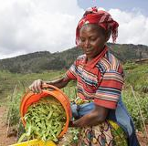

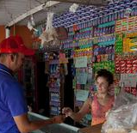
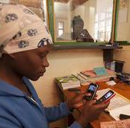
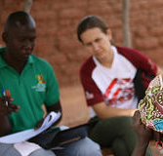


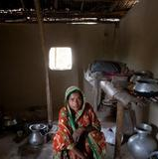
Our Program Areas
Agriculture
Education
Entrepreneurship & Private Sector Development
Financial Inclusion
Governance
Health
Peace & Recovery
Social Protection
Other Research Initiatives:
Consumer Protection
Human Trafficking
Intimate Partner Violence
Climate Change and Environment
Displaced Livelihood Initiative
Notes:
With Climate and Environment is expected to launch in 2024.

Slide 10
SECTION 2
IPA’s Researcher Diversification Strategy

Slide 11
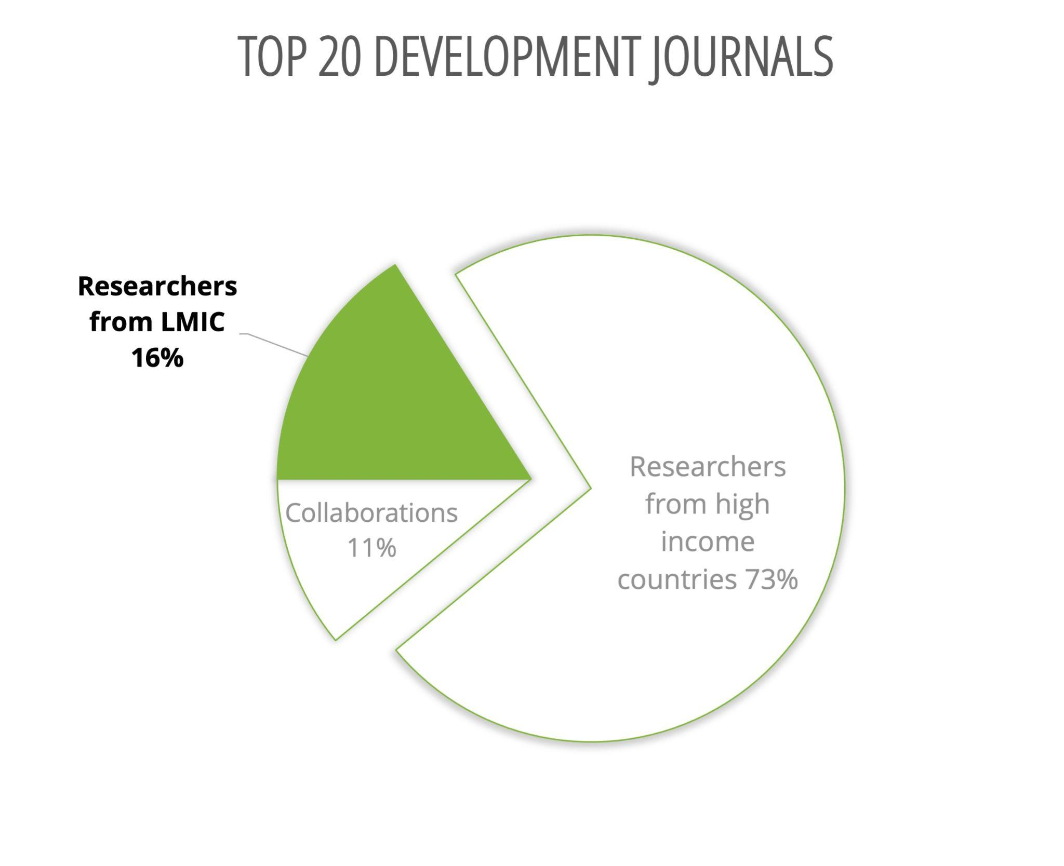


Researchers from lower middle-income countries (LMICs) are underrepresented in development research
27% of researchers in IPA network are from LMICs
Context
Source: Verónica Amarante et al., “Underrepresentation of Developing Country Researchers in Development Research,” Applied Economics Letters 0, no. 0 (August 12, 2021): 1–6, https://doi.org/10.1080/13504851.2021.1965528.
Notes:
Researchers from lower middle-income countries (LMICs) are under represented in development research. While nearly 100% of IPA's research is conducted in LMICs, only 27% of researchers in our network are from LMICs.
According to Verónica Amarante, only 16% of the research in top development journals comes from LMIC countries, indicating a significant underrepresentation.
We believe this underrepresentation may come from various factors, including limited access to research funding and resources, disparities in academic infrastructure and support, and insufficient collaboration and networking opportunities for researchers in LMICs.

Slide 12

Why are we here?
The focus of this event is to promote greater inclusivity and enhance the contribution of LMIC researchers, recognizing their unique understanding of local contexts and challenges. We are bringing top researchers together to learn about other people’s research agendas and and how IPA can help you with funding and research support.

Slide 13




S E C T I O N 2 : T E X T L A Y O U T S
Expand development research networks to include more researchers from low-and-middle income countries (LMIC).
IPA’s LMIC Researcher Diversification Strategy
Enhance access to funding for LMIC researchers.
Promote pipeline development of LMIC researchers within our country offices
Launched in 2021, the Researcher Diversification Strategy is a part of IPA’s broader strategy for diversity, equity, and inclusion.
By 2025, our goal is for 60 percent of IPA projects to include LMIC researchers.
Support LMIC researchers with research communications and policy engagement.
Notes:
This two-day seminar is a great example of how we are bringing together researchers and creating space to learn from each other and more about one another’s work.

Slide 14
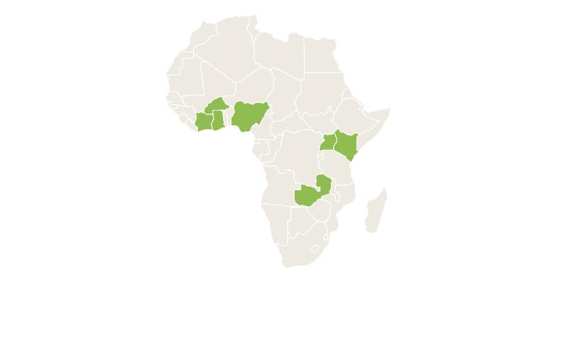
In 2021, we began increasing researcher diversification in 7 pilot countries
Burkina Faso
Côte d’Ivoire
Ghana
Nigeria
Uganda
Kenya
Mali
Zambia
We’ve recently expanded activities to Tanzania, Rwanda, Malawi, and Mexico.

Slide 15
S E C T I O N 2 : T E X T L A Y O U T S
22
MOUs
Created with universities and Research Institutions
12
Graduate Students
Gaining hands-on support
IPA LMIC Researchers:
By the Numbers
31
Direct Training Sessions
With 800 early-career scholars from government and private institutions
36
Proposals Won
With LMIC researchers as lead (36 in total since 2021)
Progress-to-date on our efforts to promote work conducted by researchers from the countries in which we work
4
Dissemination Support
Four researchers received direct support with research dissemination
41%
Active Projects with Local Researchers
Across the seven pilot focus countries
Notes:
Share the section on MOUs and active projects with local researchers - -we hope to amplify this by the end of the next two days, to help us achieve our 2025 goal of 60% of projects with LMIC researchers.

Slide 16
How We Collaborate
Dissemination
Project Development
Support throughout the project lifecycle
Project Implementation
Notes:
IPA provides support to researchers throughout the lifecycle of their projects. We match researchers with governments, NGOs and other financing opportunities.
Project development including funding
Project implementation including data collection and analysis and
Dissemination -- i will go more into that in the next slide

Slide 17
What specific services does IPA provide researchers?
• Strong in-country presence and connections
• Support with early stages of concept development, and research design
• Grants administration and financial management
• Legal support for risk management and to ensure compliance
• Institutional Review Board protocols and compliance
• Human resources and staff support
• Training services
• Data collection and management
• Communications and dissemination support for research findings
Notes:
Compliance: with, for example, local labor and data protection laws.
IPA provides a broad range of project management and research oversight services to our research network, supporting projects throughout their lifecycle. This includes (revert to slide)...

Slide 18
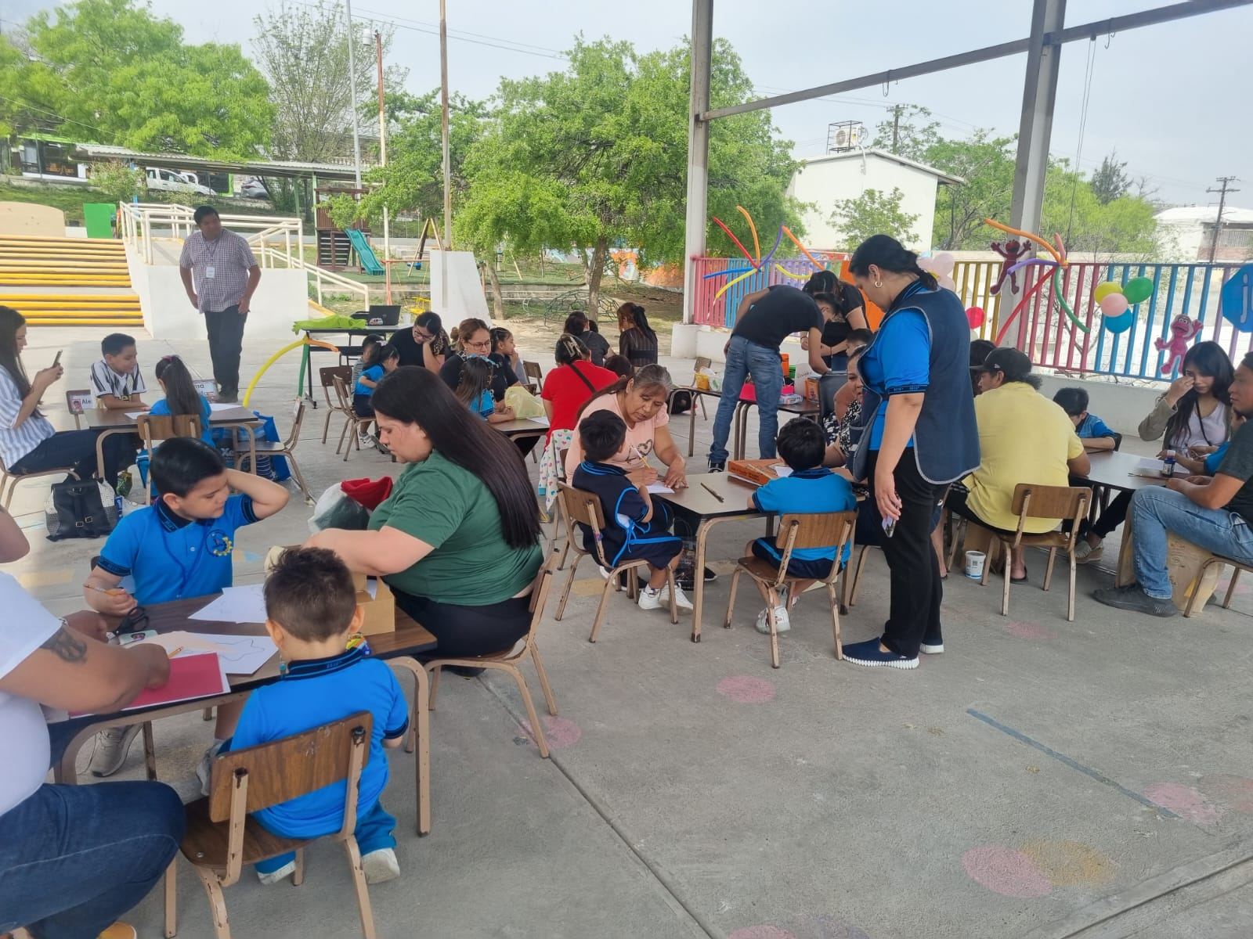
Our experienced staff can…
Matchmake!
  Partners, researchers, donors
Identify funding opportunities
Assist with design and feasibility
Support proposal narratives and budget creation
Manage grant and financial reporting
Lead data collection processes
Lead and/or support relationship with implementing partners
Share IPA resources
Evidence syntheses, quality protocols
Promote and disseminate results
Institutional Review Board protocols and compliance
Notes:
Connect researchers with implementing partners (and vice versa)
Data collection: field and survey teams to timely and cost-effective survey completion

Slide 19
Notes:
Info-mexico -- research proposal (even an early stage idea), support with collecting high quality data and/or finding partners to proceed with your research or co-PIs on a project

