Slide 1




Combining Ethnography, Radio Technology, and Qualitative Social Research to evaluate complex social and behavioural change interventions in Uganda: A methodological demonstration.
Mohazzab Abdullah
MEL Officer @ TRAC FM

Slide 2
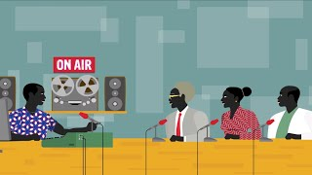
What does TRAC FM do?

Slide 3
Outcomes
Outcome 1: TRAC FM elevates citizens' awareness of their human rights and civic responsibilities
Put simply: Did participants learn about rights?
Outcome 2: TRAC FM fosters greater citizen involvement in political and civic matters
Put simply: Did participants engage in (public) discussion?
Notes:
Bottom is Theory of Change in a single quote. Recently began a campaign on Human Rights awareness, a new topic and new project for us.

Slide 4
In one quote: Theory of Change
Democratic public life only thrives where institutions enable citizens to debate matters of public importance. Jürgen Habermas, The Theory of Communicative Action (1987)
Notes:
Bottom is Theory of Change in a single quote. Recently began a campaign on Human Rights awareness, a new topic and new project for us.

Slide 5
Evaluation Methods
Radio and SMS technology used to poll the public. A baseline population of ‘uninformed’ respondents identified
Qualitative phone interviews among ‘uninformed’ baseline. Re-asked the poll question (open ended); inquired about reasons for opinion change
Ethnographic fieldwork with particularly promising respondents to understand how TRAC FM impacts public participation and discussion.

Slide 6
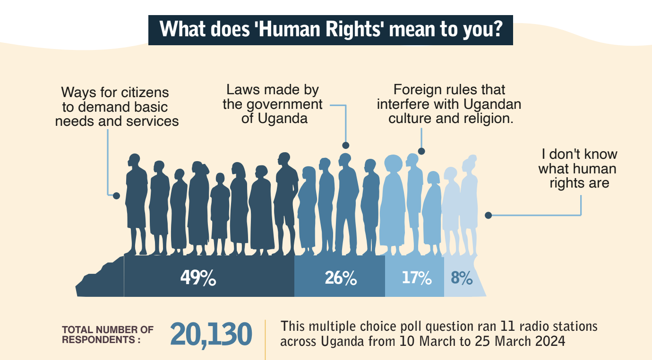
Sauti Stream Poll 1: Full poll results

Slide 7
Baseline Population: ±5,000 ‘Uninformed’ Responses
Baseline

Slide 8
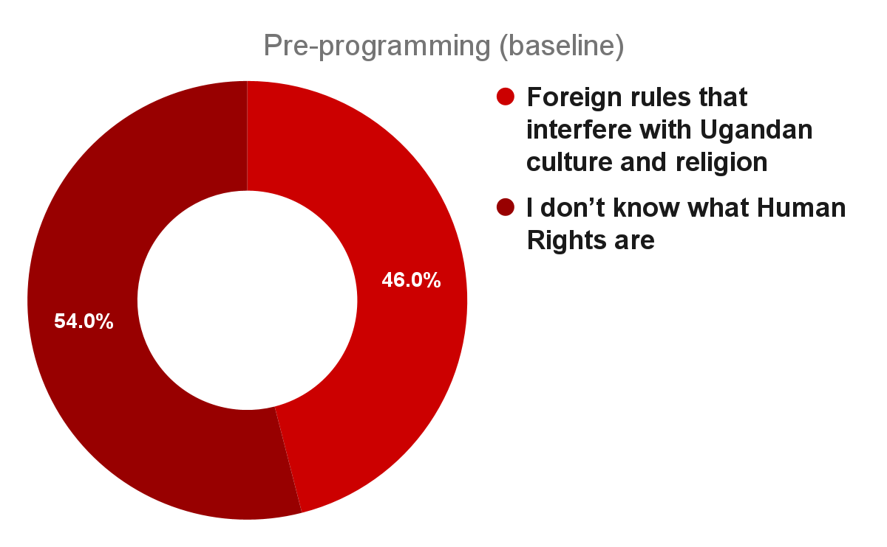
Sample for Phone Survey Follow-up: 526 Respondents
242 Participants who voted for “Foreign rules that interfere with Ugandan culture and religion”
284 Participants who voted for “I don’t know what Human Rights are.”
Both groups stratified evenly by gender and subregion.
Notes:
Asked the same poll question again.

Slide 9
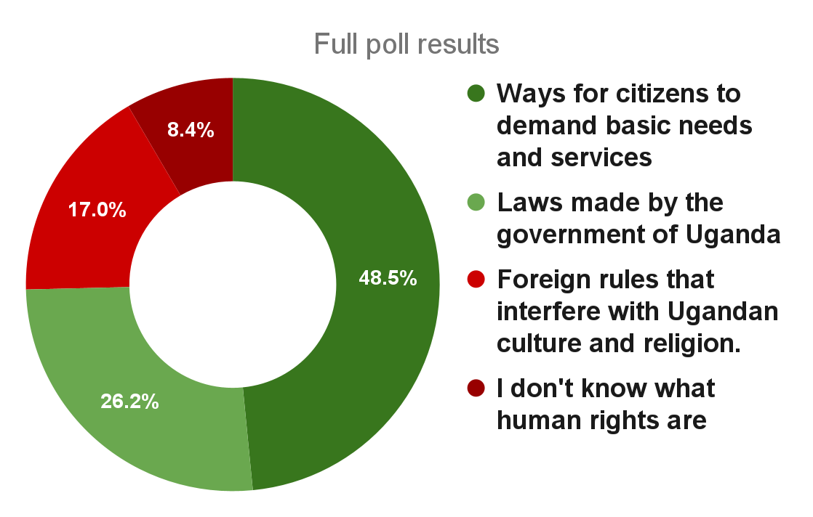
Pre-programming (baseline) views on Human Rights vs full poll results

Slide 10
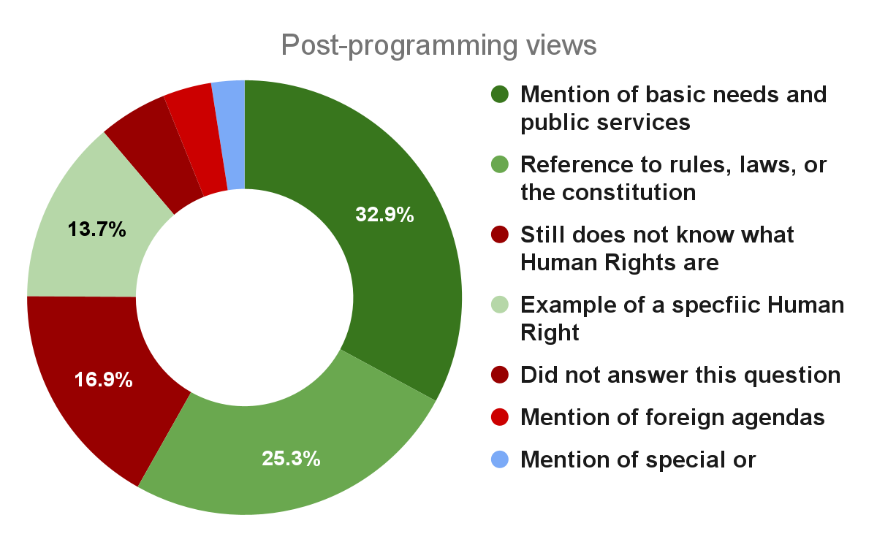
Post-programming views on Human Rights vs full poll results

Slide 11
Pre-Programming (Baseline) vs Post-programming Views

Slide 12
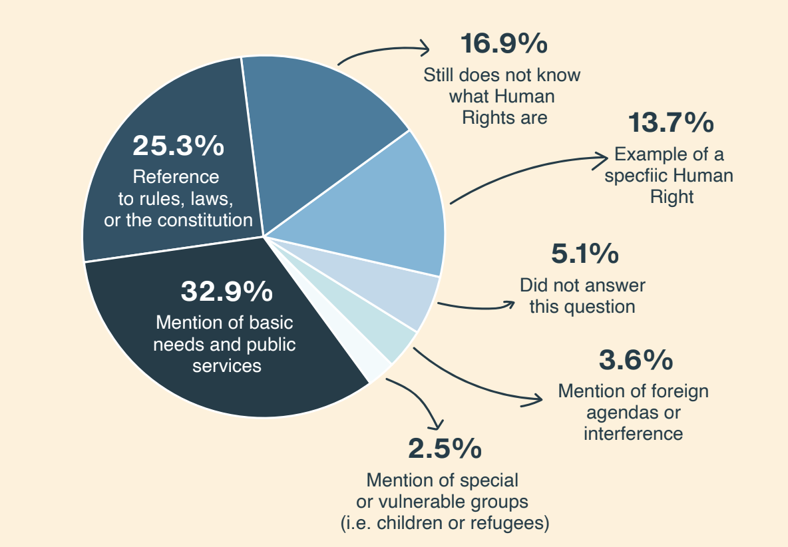
Method 1 Results
74% of the 526 respondents who were previously ‘uninformed’ or ‘misinformed’ about Human Rights demonstrated an improved understanding of Human Rights after four months of exposure to TRAC FM programming.

Slide 13

Outcomes (Yardstick)
Outcome 1: TRAC FM elevates citizens' awareness of their human rights and civic responsibilities
Put simply: Did participants learn about rights?
Outcome 2: TRAC FM fosters greater citizen involvement in political and civic matters
Put simply: Did participants engage in (public) discussion?

Slide 14
What Changed?
Participants exhibited greater knowledge around Human Rights as well as more positive opinions. Gaining knowledge might be related to the formation of more positive opinions.
What changed?
Participants were exposed to 4 radio talk shows on Human Rights, where experts discussed poll results and provided information
Participants report that being asked poll questions led to them initiating discussions and seeking information
Merely being asked questions or being given an opportunity for deliberation leads to deeper thinking, discussion, and learning.

Slide 15
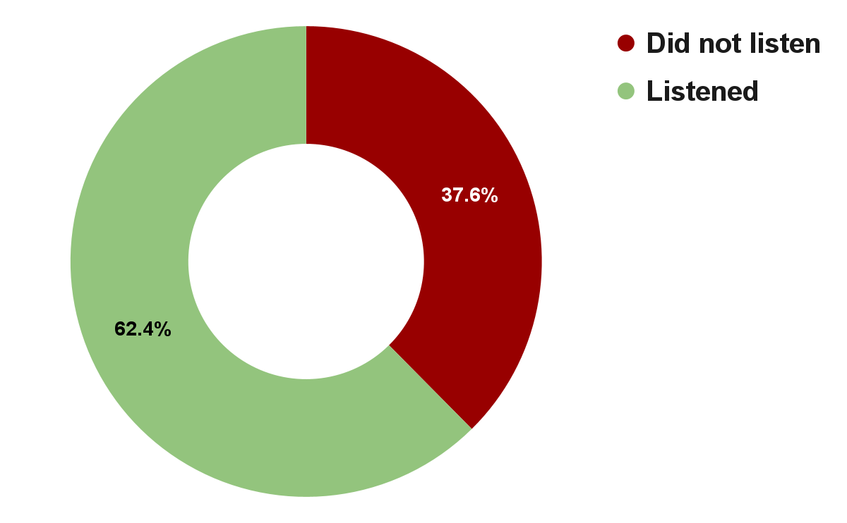
1-Among our sample, 62% reported listening to a TRAC FM talk show on Human Rights
28% of this group credited radio as the main reason for opinion change or as their primary source of information on Human Rights.
44 local-language talk shows featured discussions of poll results among expert guests from the Uganda Human Rights Commission, members of the National Youth Parliament, lawyers, journalists, and academics.
Notes:
Under half of these respondents were willing to say that TRAC FM was the only or main radio program that led to these changes.

Slide 16
Outcomes (Yardstick)
Outcome 1: TRAC FM elevates citizens' awareness of their human rights and civic responsibilities
Put simply: Did participants learn about rights?
Outcome 2: TRAC FM fosters greater citizen involvement in political and civic matters
Put simply: Did participants engage in (public) discussion?

Slide 17
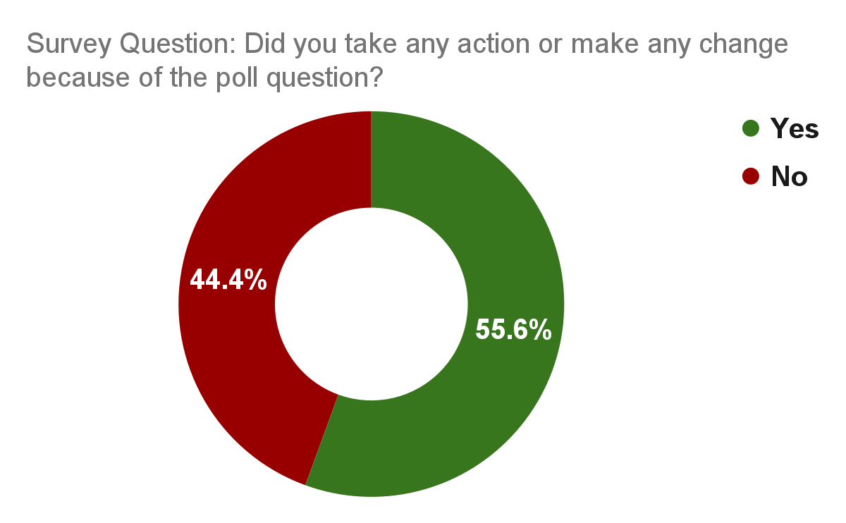
2-Among our sample, 27% report that poll questions led them to initiate discussions on Human Rights
Some respondents provided topics of discussion, unprompted:
  Violence against women and children (27 counts)
  The right to education, public schooling, and girls’ education (26 counts)
When asked to describe the action or change, 145 participants referred to discussion with family, friends, or community
Notes:
We asked more open questions about the relationship between our poll questions and respondent’s likelihood to engage in discussion. These received rich responses which are still being coded by our local-language survey team.

Slide 18
Outcomes (Yardstick)
Outcome 1: TRAC FM elevates citizens' awareness of their human rights and civic responsibilities
Put simply: Did participants learn about rights?
Outcome 2: TRAC FM fosters greater citizen involvement in political and civic matters
Put simply: Did participants engage in (public) discussion?

Slide 19
What Changed?
Participants exhibited greater knowledge around Human Rights as well as more positive opinions. Gaining knowledge might be related to the formation of more positive opinions.
What changed?
Participants were exposed to 4 radio talk shows on Human Rights, where experts discussed poll results and provided information
Participants report that being asked poll questions led to them initiating discussions and seeking information
Merely being asked questions or being given an opportunity for deliberation leads to deeper thinking, discussion, and learning.

Slide 20
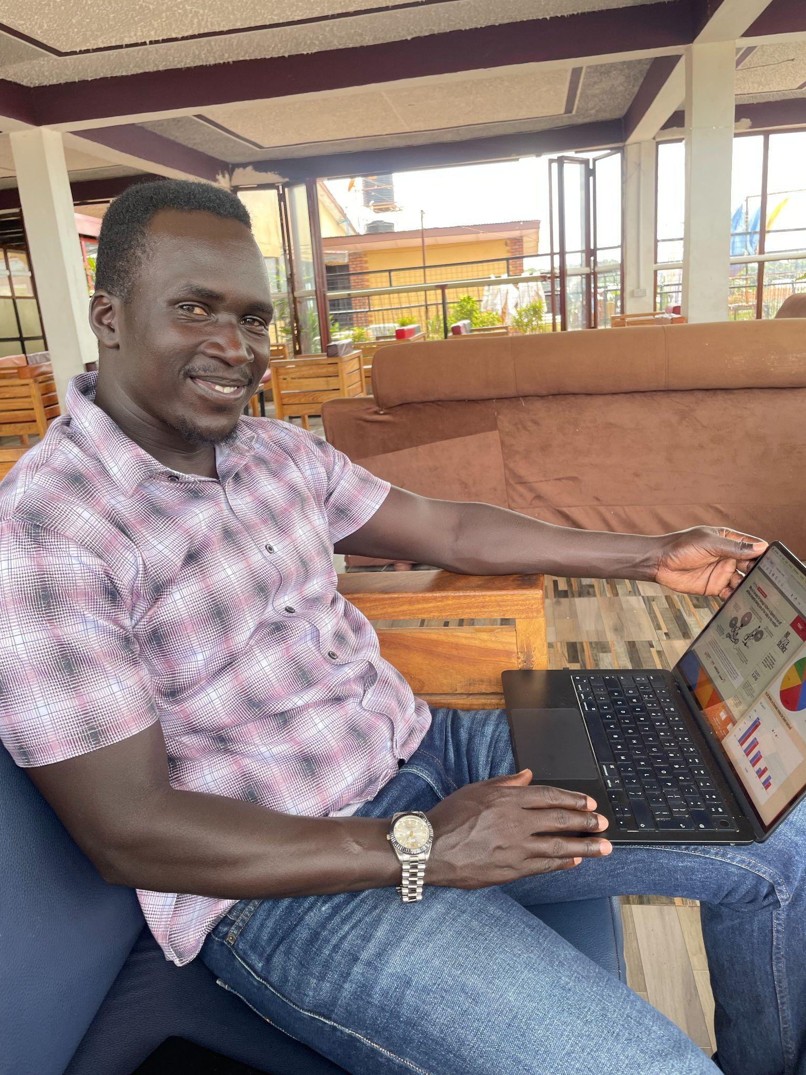
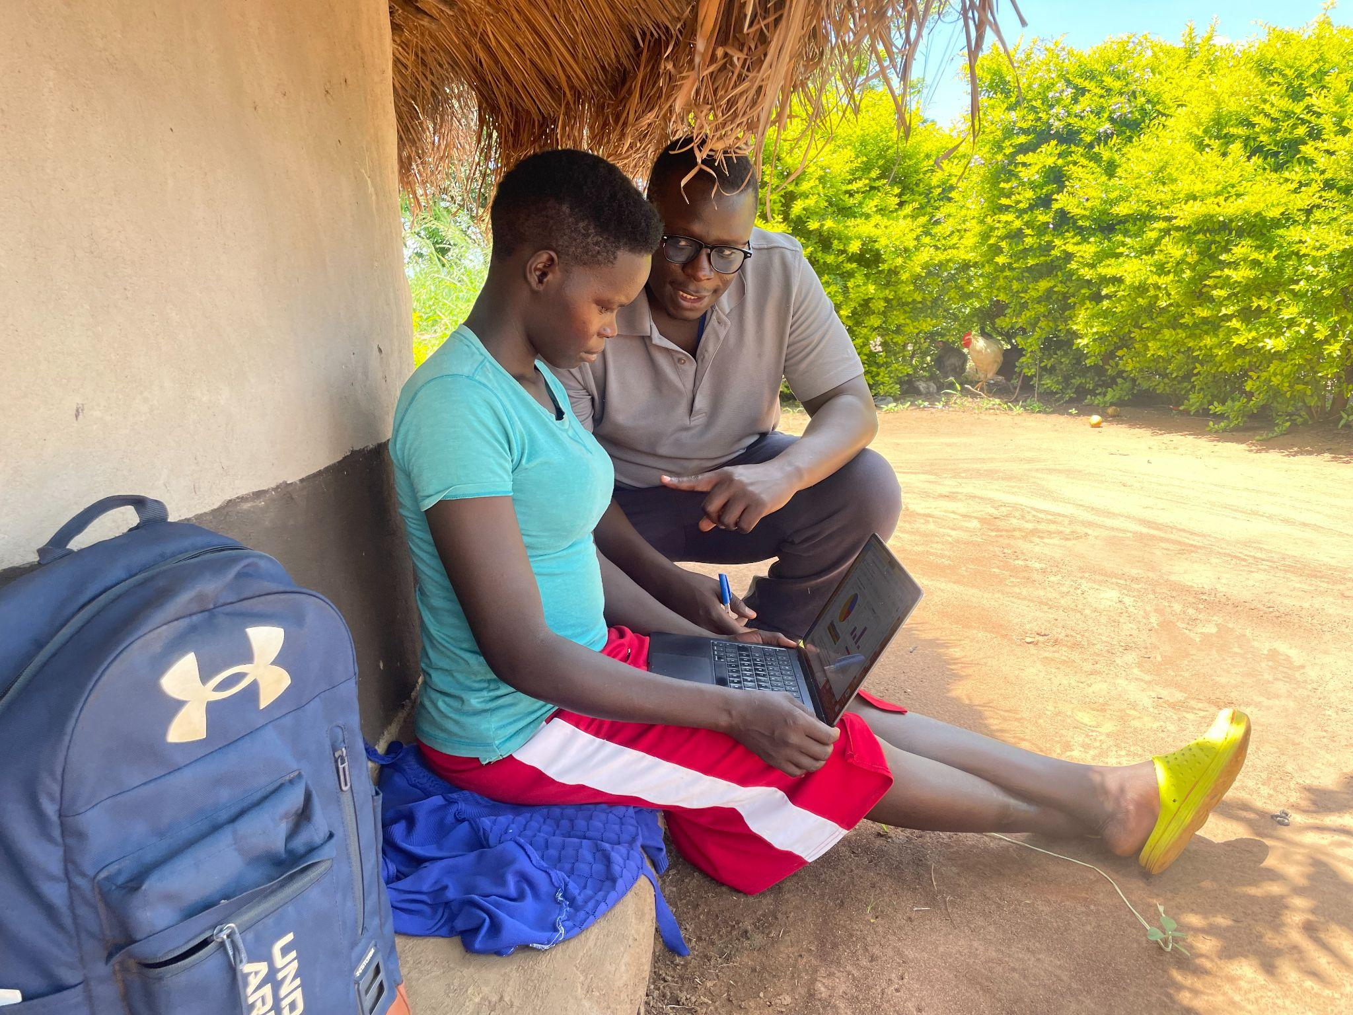
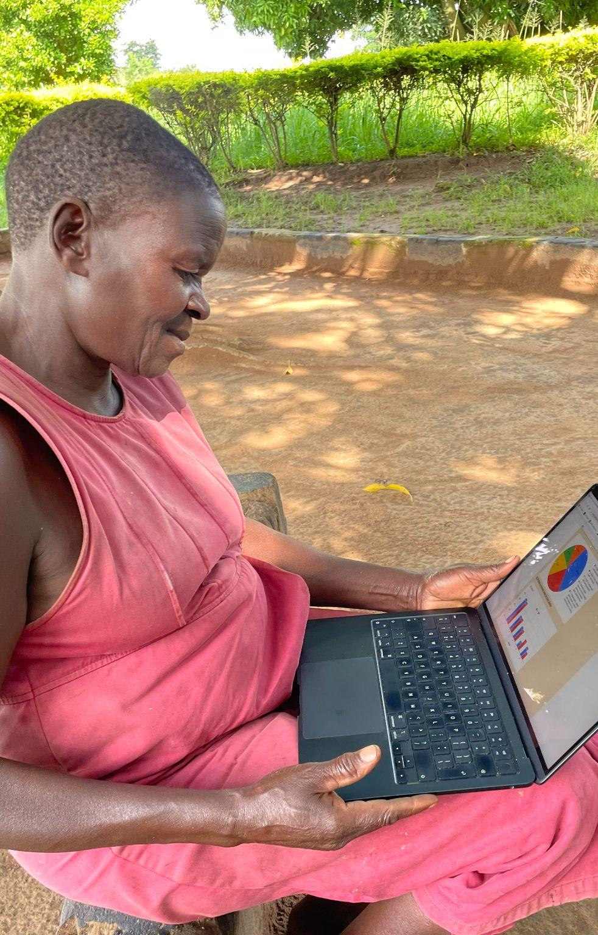
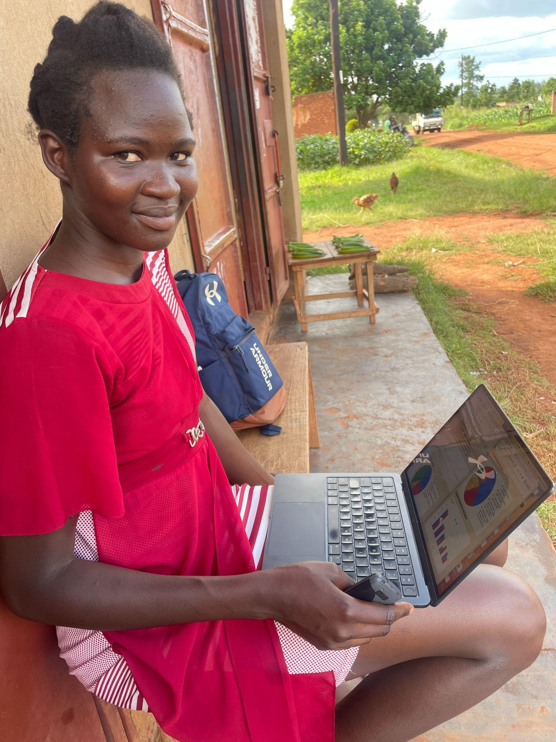
3-Ethnographic Fieldwork for Most Significant Change (MSC): 5 stories
Notes:
For a fuller picture of the value of these discussions, how they play out, and for the sake of human narratives and stories, we went afield in Gulu to interview 10 people who had provided especially promising phone interviews. 5 Thematically relevant stories are shared in the interest of time. Not meant to be representative, but INDICATIVE of the upper limits of TFM spectrum of change.

Slide 21
3-Merely being asked questions or being given an opportunity for deliberation leads to critical thinking.
“On complex social and political issues, more often than not, individuals may have views and wishes but no ordered set of preferences…
It is actually the deliberative process itself that is likely to produce such an outcome by leading the individual to further critical reflection on his already held views and opinions…
…it is incoherent to assume that individuals can start a process of public deliberation with a level of conceptual clarity about their choices and preferences which actually can only result from a successful process of deliberation.”
Seyla Benhabib (1997), The Embattled Public Sphere: Hannah Arendt, Juergen Habermas and
Beyond

Slide 22
3-Merely being asked questions – being given an opportunity for deliberation – leads to deeper thinking, discussion, and learning.
Three women found TRAC FM programming valuable because it provides rare opportunities for public participation/expression.
Encouraged by this, they discussed poll topics (and results) with spouses, friends, and family.
Pictured from left to right are Evelyn and Blessing, two of these women.

Slide 23
3-Merely being asked questions – being given an opportunity for deliberation – leads to deeper thinking, discussion, and learning.
Two stories: Blessing and her husband
After answering the poll, Blessing learned that her husband had also answered the same poll. They compared (differing) answers and tried to convince each other. Blessing succeeded.
Poll results show that her answer was in fact the most popular - hence the victorious smile!
Notes:
Husband vote: education; Blessing: Basic needs. Husband argued that without education one wouldn’t even know their rights. Blessing said that well, without clean water or food you’re not even alive to get your education. They laughed and husband conceded.

Slide 24
3-Merely being asked questions – being given an opportunity for deliberation – leads to deeper thinking, discussion, and learning.
Is it important to have polls and talk shows like this?
“Yes! You understand more when you give out your view or answer, and also listen to someone else's view. You can weigh out or balance thoughts and be corrected where you are wrong.”
Did voting on the poll feel like talking in public?
“Yes! I felt powerful. I have spoken in public before but not on radio.”

Slide 25
3-Merely being asked questions – being given an opportunity for deliberation – leads to deeper thinking, discussion, and learning.
How does talking face-to-face compare to answering radio questions?
“...Men in the [family/clan] meeting stop women [from speaking], they ridicule women. So women are shy.
But, radio is simple. If you are shy, nobody can see you, so radio can help shy ladies.”
Are you one of the shy ladies?
[Laughs] No.

Slide 26
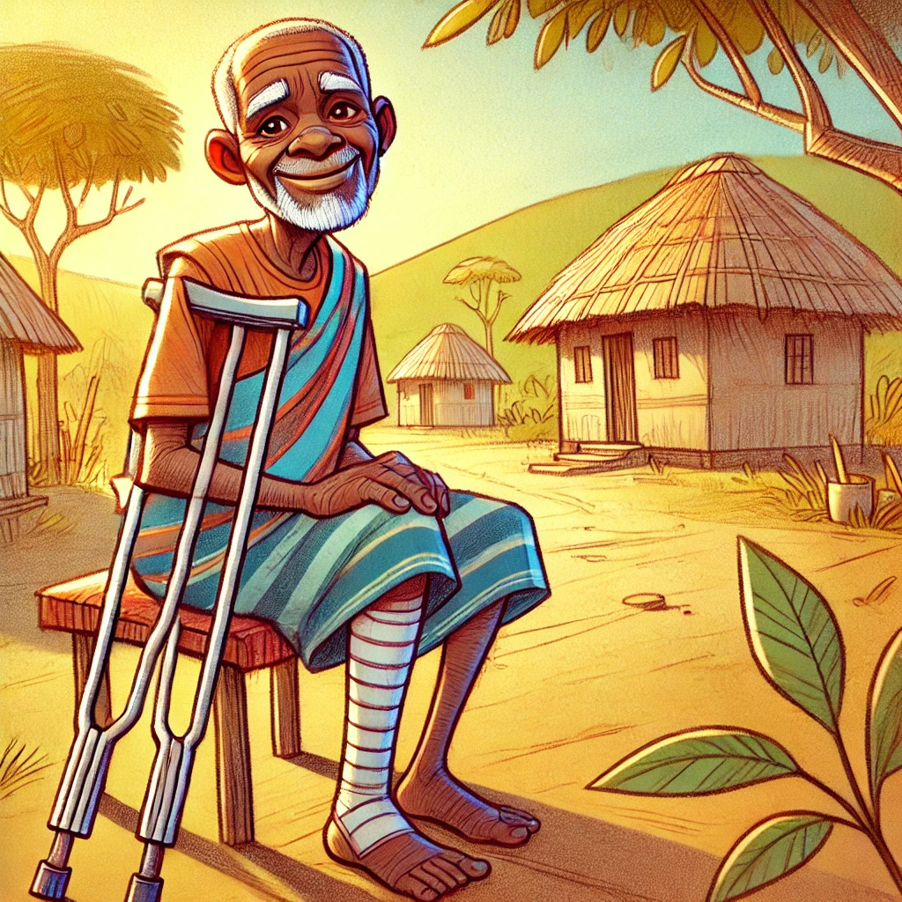
Merely being asked questions – being given an opportunity for deliberation – leads to deeper thinking, discussion, and learning.
But what about those who ARE “shy?”
Story: Mr Cham, polio survivor
Mr Cham steered the conversation towards the way families treat people with disabilities. “When you can’t contribute [financially], you are disrespected. There can be quarrelling, even beating.”
Too shy to be more specific, he maintains that his grown sons neglected his needs.
Notes:
Mr cham ditched my questions and led the conversation. He sees our current programming on HR as a chance to revisit our older programming about PWD. Cobbling business in gulu, no photo but was planned.

Slide 27
Merely being asked questions – being given an opportunity for deliberation – leads to deeper thinking, discussion, and learning.
But what about those who are “shy?”
Mr Cham did not feel confident enough to advocate for himself. “When you are weak, you may not know how to talk.”
He found it easier to simply ask his children to listen to TRAC FM programming on people with disabilities. He was surprised when “my son bought me strings to set up a [shoe cobbling] business.” Years later, his family still listens to TRAC FM programs together.
Notes:
Mr cham ditched my questions and led the conversation. He sees our current programming on HR as a chance to revisit our older programming about PWD. Cobbling business in gulu, no photo but was planned.

Slide 28
Merely being asked questions – being given an opportunity for deliberation – leads to deeper thinking, discussion, and learning.
Story: Impact on the public sphere according to veteran radio journalist, Simon Kakaum.
“Land rights is a recurring topic. Old [poll] data helps me with new shows.”
“The scripts teach me dialogue.” This helps him balance other talk shows on heated topics.
Call-ins during other shows on similar topics often reference TFM data or discussion
Journalists and researchers often call the station asking for public opinion on various topics

Slide 29
Merely being asked questions – being given an opportunity for deliberation – leads to deeper thinking, discussion, and learning.
Story: Patricia provides a sanity check
Despite reporting that she had listened to our talk show, Patricia still cannot mention examples or provide accurate descriptions of human rights.
However, she wanted to learn more about the topic and poll results. Ojara Phillip, my excellent interpreter, delivered engaging explanations.

Slide 30
Merely being asked questions or being given an opportunity for deliberation leads to discussion, information seeking
“James Fishkin, in describing an experiment with a deliberative opinion poll, speaks of how chosen participants in the sample likely began discussing the topics of the experimental poll with their friends and family from the day they discovered that they were chosen. The chosen participants may also have started paying closer attention to news media or spent more time thinking about these issues, precisely because they were chosen for the opinion poll experiment.”
Full paper, citing James Fishkin (1995), Bringing Deliberation to Democracy: The British Experiment

Slide 31
How representative are these findings?
Describing the effect of being polled on the participants of a deliberative poll:
“In all these ways their views became unrepresentative of public opinion in the conventional sense. But those views also became representative in a new and different sense. They became representative of the views the entire country would come to if it were populated by ideal citizens, by people who took up the same opportunity as the members of our sample did, to engage the issues and debate them over an extended period. In short their new, considered judgements represented what the public would think, if it actually had a better opportunity to think about it.”
James Fishkin (1995), Bringing Deliberation to Democracy: The British Experiment.

Slide 32
Unexpected Responses
“I advised a friend not to do an abortion since its a violation of the right to life.” (Phone Survey)
“Whenever my neighbours fight, I always report them to our chairman and he advises them.” (Phone Survey)
“I Educate my colleagues and friends about [the] dangers of homosexuality.” (Phone Survey)
I realised that “contraceptives encourage sex.” (Ethnographic Interview)

Slide 33
Opaque Responses
“I used to think shouting at my step children was alright but Ihave realised it affects their freedom of expression. We are now a big loving family.” (Phone Survey)
I used to quarrel with my wife, sometimes even physically. But TRAC FM taught me that this is against women’s rights so now I am a changed man. (Ethnographic Interview)
“There is a time I found someone who had spent one week without eating food. I bought food for him.” (Phone Survey).

Slide 34
References
Fishkin, James. (1995). Bringing Deliberation to Democracy: The British Experiment. The Good Society, 5(3), 45–49. http://www.jstor.org/stable/20710706
Benhabib, Seyla. (1997). The Embattled Public Sphere: Hannah Arendt, Juergen Habermas and Beyond. Theoria: A Journal of Social and Political Theory, 90, 1–24. http://www.jstor.org/stable/41802076
Davies, Rick. (2005). The ‘Most Significant Change’ (MSC) Technique: A Guide to Its Use”. 10.13140/RG.2.1.4305.3606
Abreu Lopes, C. & Srinivasan, S. (2014). Africa’s Voices: Using mobile phones and radio to foster mediated public discussion and to gather public opinions in Africa. [Working Paper]. Apollo - University of Cambridge Repository. 15. https://www.repository.cam.ac.uk/handle/1810/245269
Benhabib, Seyla. (1997). The Embattled Public Sphere: Hannah Arendt, Juergen Habermas and Beyond. Theoria: A Journal of Social and Political Theory, 90, 1–24. http://www.jstor.org/stable/41802076
Brisset-Foucault, F. (2019). Talkative Polity: Radio, Domination, and Citizenship in Uganda (1st ed.). Ohio University Press. https://doi.org/10.2307/j.ctv224v0nc.
Hammett, Daniel; Jackson, Lucy. (2018). Developing a ‘civil’ society in partial democracies: In/civility and a critical public sphere in Uganda and Singapore. Political Geography Volume 67, 145-155. https://doi.org/10.1016/j.polgeo.2017.08.004
Kamurungi, Elizabeth. (2023). EC decries lack of funds for Local Council polls. The Monitor Uganda. https://www.monitor.co.ug/uganda/news/national/ec-decries-lack-of-funds-for-local-coun cil-polls--4232176
Mamdani, Mahmood. (1996). Citizen and Subject: Contemporary Africa and the Legacy of Late Colonialism. Princeton University Press. https://doi.org/10.2307/j.ctvc77c7w
Martin, James. (2022). Rhetoric, discourse and the hermeneutics of public speech. Politics, 42(2), 170–184. https://doi.org/10.1177/0263395720933779
Mwesige, Peter G. (2009). The democratic functions and dysfunctions of political talk radio: the case of Uganda.” Journal of African Media Studies 1:2, 221–245. DOI: 10.1386/jams.1.2.221/1
Mwesigye, Godfrey. (N/A). Uganda to hold LC 1 elections after a long waiting: But why lining-up? Parliament Watch Uganda. https://parliamentwatch.ug/blogs/uganda-to-hold-lc-1-elections-after-a-long-waiting-butwhy-lining-up/

Slide 35
References
Oosterom, Marjoke A. (2016). The effects of protracted conflict and displacement on citizen engagement in Northern Uganda. Conflict, Security & Development, 16:1, 75-101. DOI: 10.1080/14678802.2016.1136140
Ackelsberg, Martha A. 1988. Communities, resistance, and women's activism: Some implications for a democratic polity. In Women and the politics of empowerment. See Bookman and Morgen 1988. As cited by Sparks, H. (1997). Dissident Citizenship: Democratic Theory, Political Courage, and Activist Women. Hypatia, 12(4), 74–110
Fraser, Nancy. (1992). Rethinking the public sphere: A contribution to the critique of actually existing democracy. In Habermas and the public sphere. As cited by Sparks, H. (1997). Dissident Citizenship: Democratic Theory, Political Courage, and Activist Women. Hypatia, 12(4), 74–110. http://www.jstor.org/stable/3810734
Shaffer, T. J. (2018). Democracy as Group Discussion and Collective Action: Facts, Values, and Strategies in Canadian and American Rural Landscapes. The Good Society, 26(2–3), 255–273. https://doi.org/10.5325/goodsociety.26.2-3.0255

