Slide 1
The Roles of collaboration between government and Civil Society Organizations (CSOs)/Non governmental Organizations (NGOs) in the implementation of Development programs for the attainment of the National Development Plan III and the Sustainable Development Goals.
By l(SBy
Laker Proscovia Imeldah

Slide 2
Theme: Development with Purpose:Empowering Accountable learning for achieving Development Goals and Enhancing Climate Resilience.
Sub-theme 1. Accountability in Development: Enhancing utilization of evidence to achieve national targets progress towards NDP IV & SDGs.

Slide 3
Background:
CSOs /NGOs in Uganda are actively implementing different development projects/programs with the purpose of achieving socio - economic transformations at households and communities levels with funding from external donors
However, given the prevailing factors of wars in the middle east and in Europe, coupled with the growing donor fatigue, effective achievement of development goals may remain a dream due to limited available resources.
On the other end, the government of Uganda through the various line ministries/agencies/programs has allocated vast resources for the purpose of achieving socio – economic transformations at households and communities levels too but this may also remain a dream due to other challenges.

Slide 4
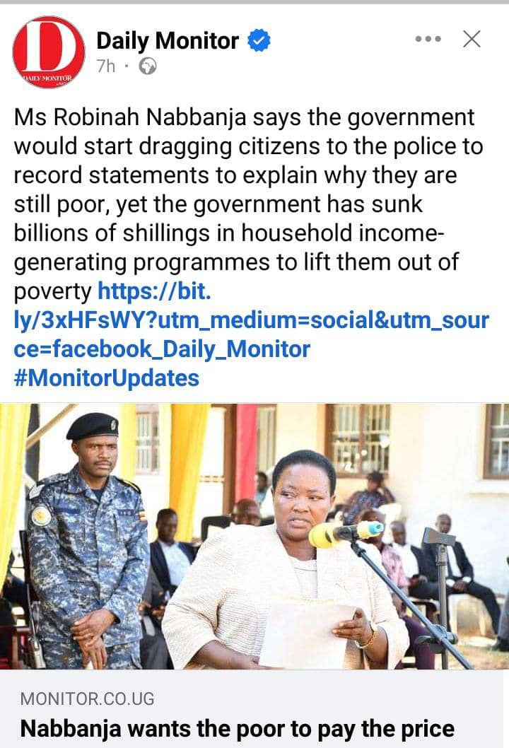
Background:
Product A
Product B

Slide 5
About CARITAS UGANDA
Caritas Uganda is the development arm of the Catholic church with its vision rooted in the Holy Scriptures…”that they may have life and have it to the fullness” (Jn. 10:10).
Caritas Uganda is implementing various programs in the sectors of agriculture (crops,animal husbandry and aquaculture), Humanitarian emergency Development, Education, Water and Sanitation and environment thus promoting the dignity of the human person created in the image of God (Genesis 1:27) as mandated by the Catholic church.
Through the 19 diocesan Caritas offices, Caritas Uganda implements projects/programs aimed at; increasing food and nutrition security, community and household incomes, leadership and good governance, charity among others; through groups formation, training the beneficiaries, advocacy and provision of start - up capital to reduce vulnerability of the poor (Improve the quality of lives of Ugandans) sustainably.

Slide 7
Findings
Access to government programs such as Emyooga, PDM, UWEP, YLP etc by the beneficiaries of CSOs/NGOs development programs inform of start-up capital (financial and in-kind) enhances the effective achievement of development goals (projects/programs results, NDP III, Vision 2040, SDGs) by bridging the gap caused by limited donor funds.
Provision of support/start-up capital to the beneficiaries of CSOs/NGOs development programs promotes diversification of HHs/Community sources of income thus increasing resilience to the shocks of climate change.
Utilising the local government officials to provide trainings to the beneficiaries of CSOs/NGOs development programs increases the chances of attaining sustainable results/development goals efficiently.

Slide 8
Conclusion
Collaboration between government and CSOs/NGOs during implementation of development projects/programs leads to the attainment of development goals efficiently, effectively and sustainably.

Slide 9
Recomendations
The government of Uganda should consider implementing the government programs such as Emyooga, PDM, UWEP in collaboration with CSOs/NGOs development projects/programs for the attainment of National Development Plan IV and the sustainable Development Goals effectively, efficiently and sustainably.
The government should prioritise collaborating with CSOs/NGOs with national coverage and established structures upto the grassroot level as that of Caritas Uganda in the implementation of development projects/programs for the attainment of National Development Plan IV and the sustainable Development Goals.

Slide 10
Recomendations Cont’d
An impact study/assesment should be conducted on two comparison groups; beneficiaries of CSOs/NGOs that accessed support from government programs such as Emyooga, PDM, YLF etc and direct benficiaries of government programs.
The findings of this impact assesment can provide stronger evidence to inform the development of a policy that will actualise the themes of this Evaluation Week; “Development with Purpose: Empowering Accountable learning for achieving Development Goals and Enhancing Climate Resilience”, Sub-theme 1. Accountability in Development: Enhancing utilization of evidence to achieve national targets progress towards NDP IV & SDGs.

Slide 11
Thank you for listening to me!

