Slide 1




Virtual Evaluation (VE) Experiences in Sub-Saharan Africa: Provide and Equip (P&E) Case Study
By: Dr. Julian K. Bagyendera
www provide-equip.com

Slide 2
Background
Evaluations can be quite costly - financially and timewise - when travelling to multiple districts and or countries
The COVID-19 lockdown opened people's eyes to the possibility of entirely Virtual Evaluations (VEs, - where routine monitoring data is available for quantitative analysis
Provide and Equip (P&E), an M&E consultancy firm based in Uganda, has been employing a blend of VEs and physical evaluations
There is increasing demand for VEs (after 2019), especially for evaluations that entail multiple countries and scattered geographical areas

Slide 3
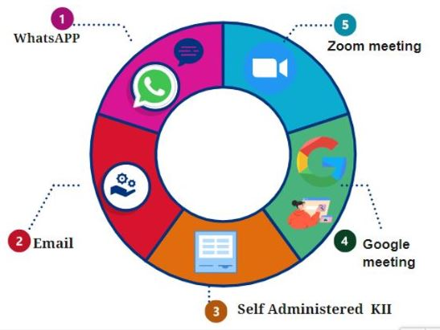
VE Methods Employed by P&E –Virtual KIIs

Slide 4
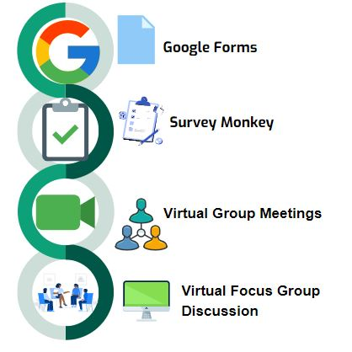
Online Survey Platforms

Slide 5
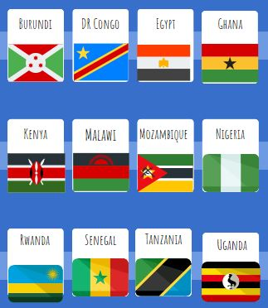
Countries where P&E Applied VEs
1. Burundi
2. DR Congo
3. Egypt
4. Ghana
5. Kenya
6. Malawi
7. Mozambique
8. Nigeria
9. Rwanda
10. Senegal
11. Tanzania
12. Uganda

Slide 6
Findings

Slide 7
Findings
Positives Associated with VE Methods
Reduced travel costs 💰
Reduced travel time ⏰
Increased flexibility 📱
Wider consultations that are not limited by travel
Enhanced data quality, especially with inbuilt checks aided by online tools
Real-time ⏰data collection and data analysis, which facilitates quicker report writing and decision-making

Slide 8
…Findings
Negatives Associated with VE Methods
Low response rates for self-administered tools
Limited ownership of electronic gadgets, which limits accessibility
High data costs
Poor internet connectivity in remote areas
Technology phobia among the older generation, - reluctancy to use technology due to digital illiteracy
Some phones were switched off for an extended period due to charging challenges
Some targeted project beneficiaries had registered using other people's phones, e.g. Spouses, neighbours, and group leaders; some were no longer in touch

Slide 9
Conclusions
Although several challenges still prevail, limiting VE application, the challenges can be worked around to conduct successful VEs
Flexibility and mindset change are required to scale up the adoption of digital technology
More rigorous follow-up and encouragement for online respondents is essential for improved response rates
An enabling environment with reduced taxation on data & digital gadgets, plus increased coverage of more affordable networks, are essential for increased applicability and effectiveness of VEs

Slide 10


End Thank you
May God bless you
Comments & Questions?

