Slide 1
Twaweza East Africa, August 19 - 23, 2024
Powering Communities to Navigate Local Challenges and Build Climate Resilience: A case of Participatory Action Research in Kole District
Presentation by:
David Mugurusi et al
Notes:
1

Slide 2
About Twaweza
We are a regional civil society organization with programmes in Kenya, Tanzania and Uganda since 2010.
Twaweza works through Research, evidence and action to enable citizens’ voices, interests and experiences to be heard and governments to be responsive.

Slide 3
What is the problem
broken citizen-government relations
low citizen agency
weak civil society
poor government responsiveness

Slide 4
Twaweza Mission
Mission 1: Demonstrating agency and responsiveness in action to foster collaboration and trust between citizens and their governments
Mission 2: Generating evidence to enhance insight, prompt debate, and amplify voices for better decisions and actions
Mission 3: Strengthening civil society sector to enhance its legitimacy and impact
Ultimately, we aim to contribute to realizing better lives for all citizens by influencing
institutions of local government to embrace accountability and inclusion

Slide 5
Demonstrating citizen agency
Uraghbishi Initiative
An initiative to activate citizen agency in East Africa
Focus
Demonstrating how citizens can systematically come together to solve their problems
Increasing citizen participation in decision-making
Improving local governance and public services

Slide 6
Uraghbishi (Participatory Action Research Process)
Assessment (identification & ranking)
Analysis (HTL, RCA, GA, SHPM)
Developing the action plan
Citizen Follow-up Committees
PAR awareness meetings
Selection of Change Agents
Change Agents training
Problematisation at the community level
New information
Refining action plans
Follow up
Conscientization
Action and Review
Reflection & Learning
Dialogue and Feedback
Contributions
Request letters
Response

Slide 7
Coverage
40,155 PEOPLE REACHED (20,476 WOMEN & 19679 MEN)
5 Districts
Collaborating with 5 local CSOs
30 Sub-Counties/Town Councils
60 Parishes/Wards
60 Villages
Working with 120 Change Agents
60 Action plans
180 Priority Issues

Slide 8
Priority issues
Notes:
1.7.2013
9
‹#›

Slide 9
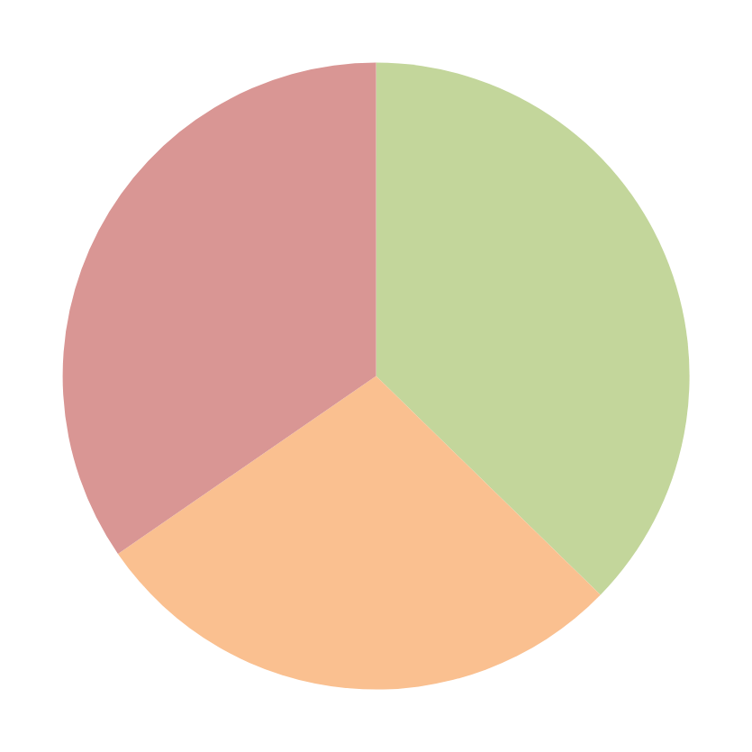
Action plan Implementation Status as of Nov 2023
Pending 34.6%
Solved 37.3%
In progress 28.1%

Slide 10
Documentary
This video shows details of the entire process, from setting priorities and identifying key problems to addressing these issues. Significant improvements have been noted in areas such as water and education, which were major challenges before the introduction of Uragbhishi work in the communities

Slide 11
Results
Enhanced Community Participation in decision-making
Citizens attend meetings and actively contribute ideas, and demand accountability
Participation of women and youth
Revived Collective Actions
Communities have taken initiatives like cleaning access roads and water sources, discussing GBV, and improving public meeting participation, e.g. Bulungi Bwansi.

Slide 12
Results
Increased Information Flow
Communities are more proactive in seeking information from the government, leading to increased knowledge and confidence in addressing their development issues.
Improved Government Responsiveness
The government has addressed 41 issues through dialogue and consensus on community priorities.
Notes:
12

Slide 13
Key lessons
Listening - with the mind, heart, and intention
The correct problematizing enabled communities to understand the roots of their issues and design innovative solutions.
Working on the actual (felt) needs of diverse populations. Touching emotions, hearts and expectations.
Freedom - to plan and execute without interference but with consideration of the existing system excites the community

Slide 14
Key lessons
Adequate feedback, even if there are no results. They need to know what is going on.
Community pooling of resources for short-term solutions demonstrated their power and potential impact when combined with government action.
Young people show great potential for continuity despite a 30% attrition rate due to life changes.

Slide 15
For more information:
www.twaweza.org
@twaweza_uganda
@Twaweza East Africa

