Slide 1
Topic: The Government's effort to enhance drought Resilience in the Lokere Catchment, Kyoga Water Management Zone, Karamoja, Uganda Workshop: The 8th Uganda Evaluation Week 2024
Presented by: Alice Ninsiima s)

Slide 2
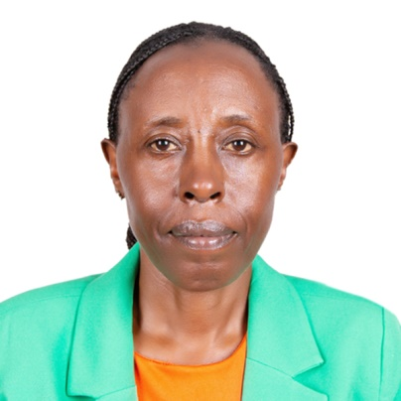
About The Presenter-Alice Ninsiima
Seasoned Development Expert & Monitoring and Evaluation Specialist
With over ten years of experience in the public sector, Alice Ninsiima has established herself as a leading expert in monitoring and evaluation, research, and development studies. Her extensive background in technical assistance, community development, and water and environment sector management has equipped her with a unique blend of skills and knowledge.
Professional experience: Technical monitoring officer, ministry of finance, planning and economic development’; Over ten years of experience monitoring and evaluating state and non-state enterprises; Conducted various evaluations and research studies; Community development specialist, ministry of water and environment offering technical guidance to local governments in planning, development, and reporting
Education: Master's degree in development studies-Nkozi university; - Bachelor's degree in Social Sciences, Makerere University;- Postgraduate Diploma in Management-Uganda Management Institute (UMI);
Other training and certifications: International Planning and Evaluation for Development (IPDET), Carleton University, Canada; Center For Learning on Evaluation and Results for Anglophone Africa (CLEAR-AA); Over ten years of membership with the Uganda Evaluation Association (UEA); - Various trainings in M&E.

Slide 3
Presentation outline
Introduction
Methodology
Significance of the study
Government efforts/Interventions
Opportunities/Threats
Conclusion and Recommendations

Slide 4
Introduction
Prolonged and widespread drought is a recurrent feature that is exacerbated by Climate Change phenomena, advancing desertification and ecological degradation in the four riparian countries of Djibouti, Kenya, Sudan, and Uganda within the Intergovernmental Authority on Development (IGAD) Region
Focus of the study was in Lokere Catchment, Kyoga Water Management Zone, in Kaabong , Moroto , Kotido Napak and Nakapiripirit in the Karamoja Region and; Amuria , Katakwi and Soroti in Teso Region (Uganda).
Climate Change has aggravated the impacts of droughts manifested in form of acute water constraints resulting from high rainfall variability and increasing temperatures.
Future climate change projections between 2030 and 2080 paint a gloomy picture characterized by high rainfall variability and increased temperatures

Slide 5
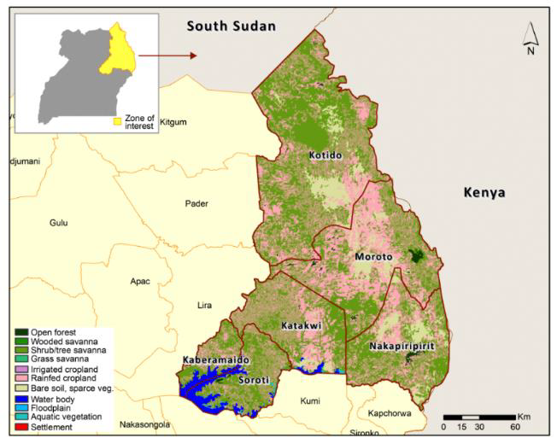
The Lokere Catchment

Slide 6
Introduction Continued
In Uganda, the climate is not only a driving force but also a key determinant of the status of natural resources, such pattern in Lokere catch as water resources, forest, agriculture, ecotourism, and wildlife
The precipitation is classified as bimodal, but is highly variable in space and time, with high peak events and long dry periods
The rainfall level ranges from 400 to 2200 mm per year with two seasons (March to June, and August to November)
It is characterized by prolonged dry spells and erratic rainfall with flash floods that erode soils, leaving deep gullies.
Total crop failure, loss of livestock and this has far-reaching impacts on food security, leaving communities vulnerable to starvation; reduced water and pasture for livestock; disease outbreaks; loss of biodiversity and increased resource use conflicts.
Major focus is the resilience of small holder farmers and pastoralists in line with global climate agenda 2030, NDP III objectives and contributions to SDG Goal 13 (Climate Action) and plan for NDP IV

Slide 7
Significance of the study
The findings and recommendations will inform policy makers, practitioners and researchers working toward climate resilience and sustainable development
Contribute to Sustainable Development Goal 13 (Climate Action)
Support vulnerable communities in achieving climate resilience in Lokere Catchment

Slide 8
Methodology
Mixed-methods approach (quantitative and qualitative methodologies) were used in primary and secondary data collection
These included:
Desk reviews
Key Informant Interviews (KIIs)
Focus Group Discussion (FGDs)
Observations in the field
Data analysis

Slide 9
Interventions
S/N | Project Name | Project Location | District | Population Served | Villages Served
1 | Kaabong | Kaabong | Kaabong
2 | Kotido | Kotido | Kotido
3 | Orwamuge Piped Water Supply system | Orwamuge | Abim | 21,512 | 25
4 | Nakapiripirit | Nakapiripirit | Nakapiripirit
5 | Abim piped water supply system | Abim TC | Abim
6 | Alerek Piped Water Supply system | Alerek | Abim | 53,298 | 12
7 | Kacheri-Lokona Piped Water Supply system | Kacheri Lokona | Kotido | 72,973 | 24
8 | Namalu Piped Water Supply | Namalu RGC | Nabilatuk | 70,538 | 12
9 | Morulem Piped Water Supply | Morulem RGC | Abim | 92,871 | 56
10 | Amudat Piped Water Supply | Amudat TC | Amudat | 10,372 | 16

Slide 10
Interventions
Dams and Valley tanks
Kobebe Dam in Moroto completed in 2011 with capacity of 2.3 million m3 and can serve upto 268,000 Livestock Units.
Arechek Dam in Napak completed in 2011 with capacity of 2.1 million m3 and can serve upto 245,000 Livestock Units.
Kailong Dam in Kotido completed in 2011 with capacity of 0.167 million m3 and can serve upto 20,000 Livestock Units.
Longoromit in Kaabong completed in 2011 with capacity of 1.4 million m3 and can serve upto 163,000 Livestock Units.
Kawomeri Dam in Abim completed in 2011 with capacity of 1.3 million m3 and can serve upto 151,000 Livestock Units.
Upto 105 parish level communal valley tanks constructed across Karamoja using Ministry Equipment units under the various projects: KALIP, GIZ, OPM-MWE MoU. These constitute 1 million m3 of water storage to water 160,000 livestock units.

Slide 11
Interventions
Mini irrigation systems
Upto 42 acres of land, serving 82 beneficiaries, is currently under irrigation for the various schemes: Arechek in Napak, Akadokulu and Puno in Abim, Longoromit in Kaabong and Moruese-Naro in Karenga.

Slide 12
Interventions
2 New Automatic Weather Stations have been set up in Moroto (Rupa), and Napak (Matany).
1 Early warning information Center serve the Karamoja region under renovation
145 phones and 145 solar radios procured for 145 farmers’ groups to help access of Early Warning information.
21 local level meetings have been held to disseminate early warning information in Moroto, Napak, and Nabilatuk.
1 Emergency Response Plan for Drought Disasters prepared for Lokere.

Slide 13
Interventions continued
1 Drought Management Plan prepared for Lokere Catchment.
943 farmers (377 Male, 566 Female) trained in the climate smart growing of vegetables and maize using zai pits, and vegetable basins in Moroto, Napak, and Nabilatuk.
6 Acres of agricultural land covered with Soil and Water Conservation measures i.e., infiltration trenches and demi-lunes (Nakonyen in Tapac, and Longolok in Lotisan).
1917kg of seeds distributed to 60 Groups of Farmers: 600kg of Maize MM3, 600kg of Greengram, 712kg Cow Peas, Tomato (Cal J), 2kg Onions (Red Creoles), 2kg Green Pepper, 2kg Sukuma Wiki, 2kg Spinach, 2kg Egg Plants.

Slide 14
Opportunities and challenges
Positive
Negative
EWS put in place Feature
Emergence Response plan being made
Farmer Field Schools
Limited timeliness, accuracy, accessibility of information
Climate Change (erratic rain, floods, dry spells, disease outbreak etc)
Low levels of learning

Slide 15
Conclusion
Government has done a lot to enhance drought Resilience in Karamoja region and specifically Lakere Catchment.
There is an EWS centre in place and provision of phones and radios to famers
Farmers are trained in the climate smart growing of vegetables and maize
Soil and Water Conservation measures
However, Strengthening an effective early warning system (EWS) is a prerequisite for timely response to avert and mitigate the impacts of disasters
Timeliness, accuracy, accessibility, for early warning information elicits early action
Maximise benefits of IEWS and conventional EWS for better results.

Slide 16
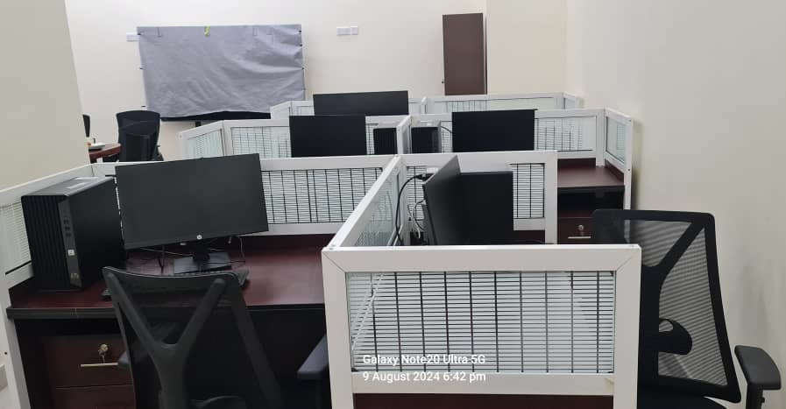
Weather station and Equipment at Early Warning Center in Moroto

