Slide 1
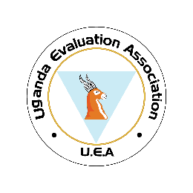
Solid Waste Management and Disaster Risk Reduction: A Conceptual Framework for Climate Change Resilience and Adaptability.
By
Anna Elsie Luyiggo

Slide 2
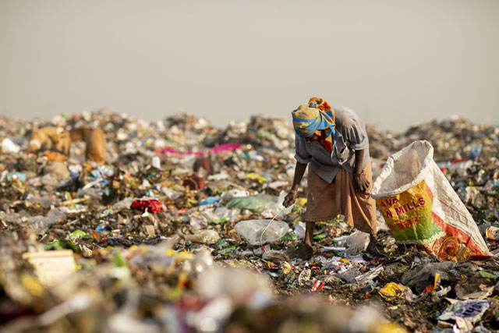
Introduction
Urbanization and population growth have led to an unprecedented increase in solid waste generation, with cities worldwide producing an estimated 2 billion tons of solid waste annually (World Bank, 2018). This surge in waste production, coupled with inadequate waste management infrastructure, has resulted in significant environmental and public health challenges, particularly in developing countries. In Kampala, Uganda, the Kiteezi landfill, the largest in the country and East Africa, exemplifies these challenges. Originally designed to serve a smaller population, Kiteezi has long exceeded its capacity, leading to various environmental hazards, including leachate contamination, air pollution, and methane gas emissions (Aryampa et al., 2019).

Slide 3
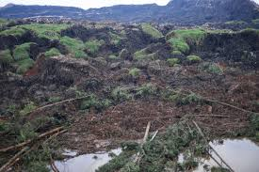
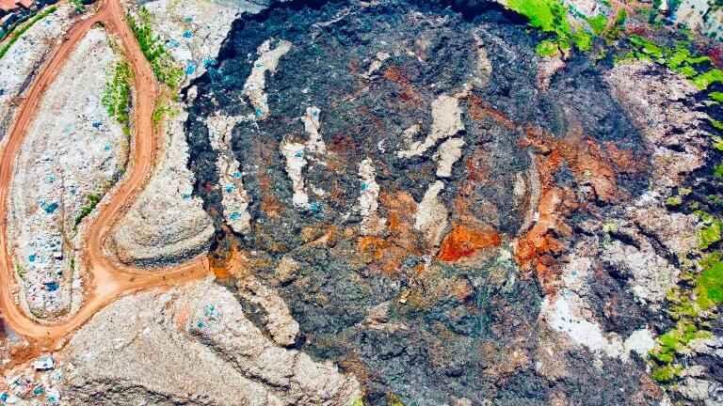
Situational Analysis
The Growing challenge of Waste Management
Kampala, with a population of approximately 4,051,000, produces an estimated 1,500 tons of waste daily, of which only 40-50% is adequately collected and disposed of.
Overcapacity of the landfill, leading to significant environmental and safety concerns.
Kiteezi landfill, spans 35 acres and serves as the primary waste disposal site for the city.

Slide 4
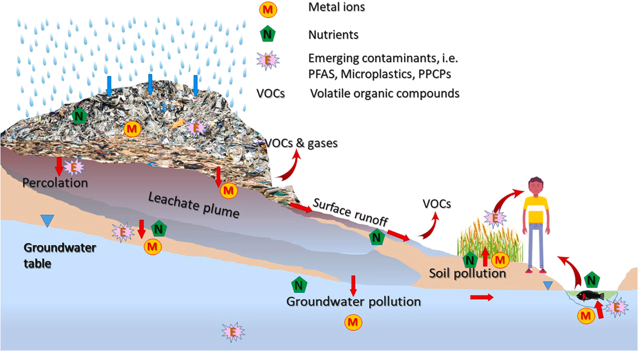
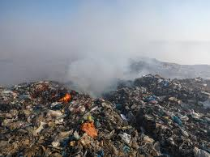
Situational Analysis
Environmental and Public Health Risks
Inadequate management practices at kiteezi have resulted in numerous environmental hazards, including soil, air, and water contamination.
Severe risks associated with overcapacity and improper waste handling, causing extensive damage to surrounding communities.
Emission of methane gas, leachate leakage, and toxic air pollutants pose ongoing threats to public health and safety.

Slide 5
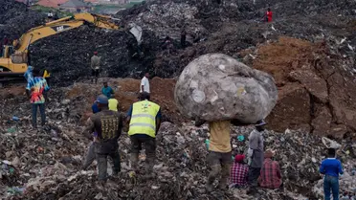
Situational Analysis…(continued)
Community Vulnerability and Perception
Communities surrounding the kiteezi landfill are among the most vulnerable, facing health risks and environmental hazards daily.
There is a significant gap in disaster preparedness and risk mitigation efforts among both residents and local authorities.
Policy and management gaps
Uganda's national policy for disaster preparedness and management outlines critical actions for resettling high-risk populations and integrating risk reduction strategies into development planning.
Implementation is hampered by limited funding, inadequate legal frameworks, and poor enforcement.
NEMA (waste management) regulations, 2020, emphasize the need for disaster preparedness but fall short in addressing landfill-induced disasters comprehensively.

Slide 6
Theoretical framework
The DRR framework, as laid down by the United Nations Office For Disaster Risk Reduction (UNDRR).
A systematic approach to identifying, assessing, and reducing risks of disasters. key components include risk assessment, prevention and mitigation, preparedness, response, and recovery.
Grounded in the concept of minimizing vulnerabilities and enhancing resilience to disasters through systematic efforts.
Emphasis on prevention, preparedness, and community resilience
The study will explore factors such as inadequate waste management practices, environmental degradation, and social vulnerabilities that heighten disaster risks near landfills.
Act as a baseline to evaluate current policies, governance structures, and community-based initiatives aimed at mitigating these risks and enhancing sustainable urban development.

Slide 7
Research Objectives
The paper aims to address this gap by developing a framework that integrates SWM with DRR to enhance climate resilience and adaptability in urban areas, using Kiteezi landfill as a focal point. The specific objectives are to:
Analyze the current SWM practices at kiteezi landfill and their associated disaster risks.
Explore the role of climate change in exacerbating these risks.
Develop a framework that links SWM with DRR to mitigate disaster risks and enhance climate resilience.
Propose policy recommendations for integrating SWM and dRr into urban planning in Kampala.

Slide 8
Research Questions
What are the practices, gaps, and specific risks associated with municipal solid waste management at the kiteezi landfill in kampala?
How do the practices of municipal solid waste management affect social change and conditions?
What is the role of climate change in exacerbating these risks.
How do the people and government perceive and assess the risk?
Who are the main actors involved in managing the landfill and what are their roles?
What lessons can be learned from other waste management strategies around the world?
What recommendations can be made based on the study findings?

Slide 9
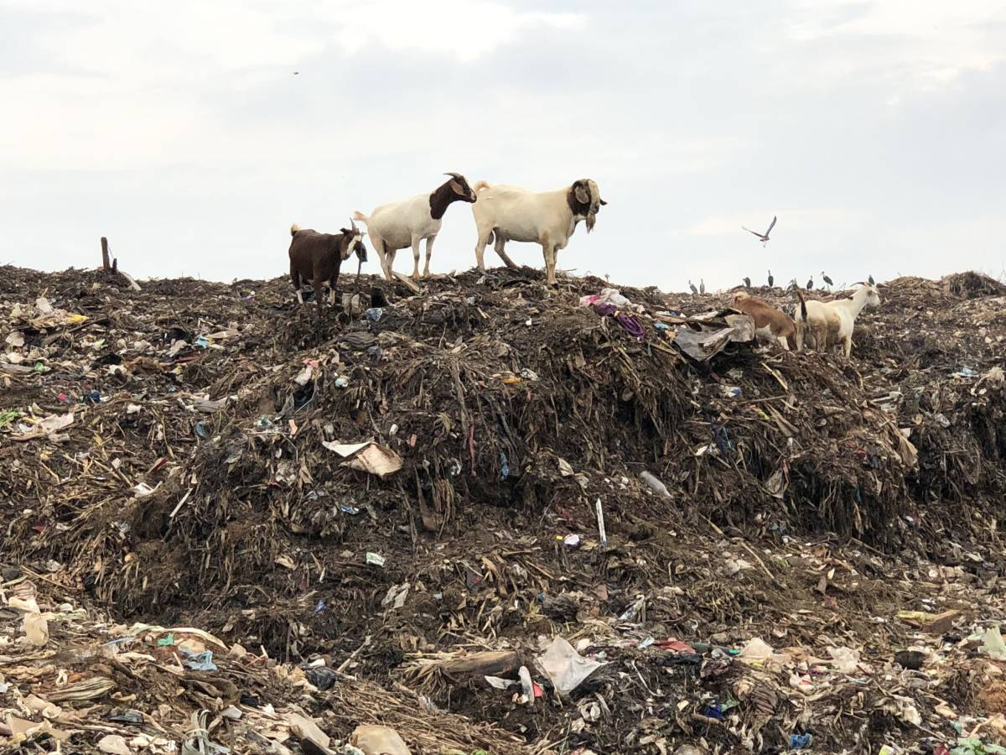
Study scope
Content: Kiteezi Landfill, Municipal Solid Waste Management
Geographical : Latitude: 0° 25′ 0″ and Longitude: 32° 34′ 00″ In Nangabo Sub-county, Wakiso District 13 Km from Kampala City Centre.

Slide 10
significance
By linking SWM with DRR, the study will provide a holistic approach to addressing the environmental and disaster-related challenges posed by overburdened landfills in the face of climate change.
The framework not only aims to reduce disaster risks but also to improve public health, environmental sustainability, and the overall quality of life for urban populations.
Inform policy development.

Slide 11
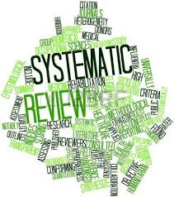
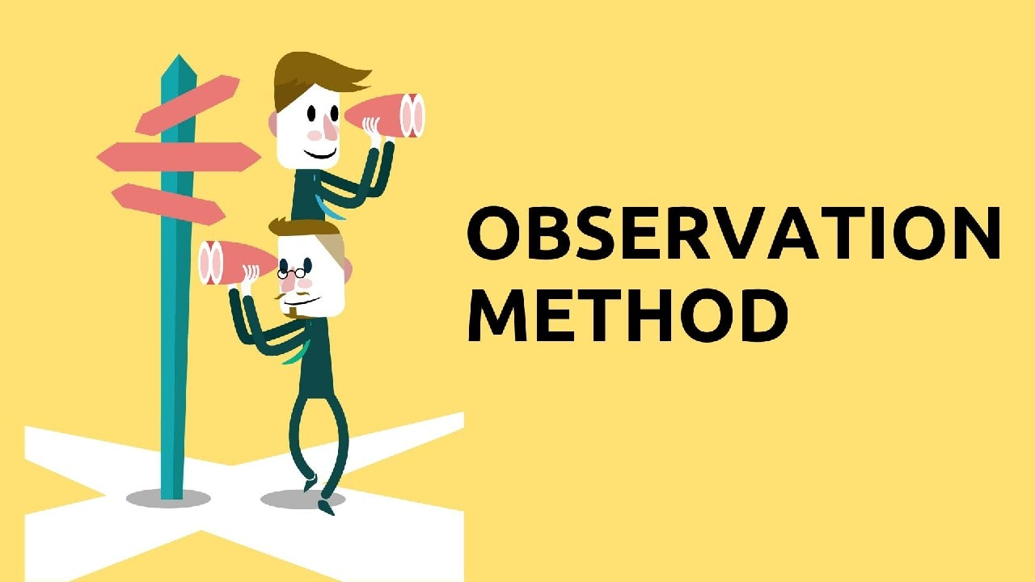
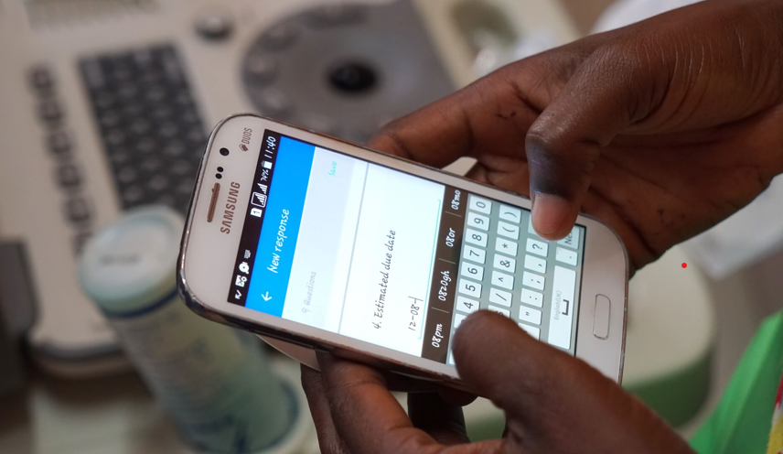
Methodology
Approach: Participatory Mixed Methods
Research Design: Descriptive And Explanatory Designs
KIIs
FGDs
Rapid Assessment Surveys

Slide 12
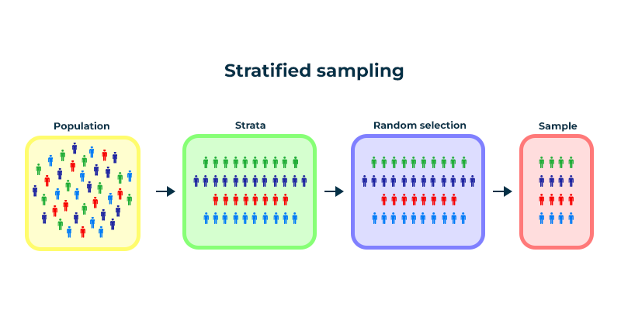
Sampling Strategy
Strata include: landfill workers, residents, private sector waste management firms.
Purposive sampling to select key informants and participants with rich insights into the study.
KCCA official
NEMA representatives
local council leaders
landfill management personnel, environmental and health experts
managers of private waste management firms in Kampala
CSOS
academic institutions
community leaders

Slide 13
Data analysis
Quantitative: descriptive statistics (measures of central tendency) using statistical software (e.g., spss, r) to analyze survey data and identify significant patterns and relationships (inferential statistics).
Qualitative: qualitative analysis software (nvivo, max qda) to code and analyze interview and focus group data for thematic content.
Triangulation
integrate findings from both quantitative and qualitative data to draw comprehensive conclusions.

Slide 14
Reporting
Study report will be written
Dissemination of findings
Academic Publication and Policy Briefs.

