Slide 1






Josephine Watera
Head Monitoring and Evaluation Division
Parliament of Uganda
The Republic of Uganda
STANDARDIZING EVALUATION PROCESSES: EXPERIENCES OF THE IMPLEMENTION OF THE SELF ASSESSMENT TOOLKIT IN THE PARLIAMENT OF UGANDA

Slide 2

Outline of presentation
Highlights of Uganda Parliament
Introduction to evaluating Parliaments
The Key Question
Frameworks for evaluating Parliament
Overview of the IPU Self-Assessment Toolkit
When to use the tool
Standardization Process and Outcomes
Uganda Parliament Approach to the Assessment
What remains to be done

Slide 3
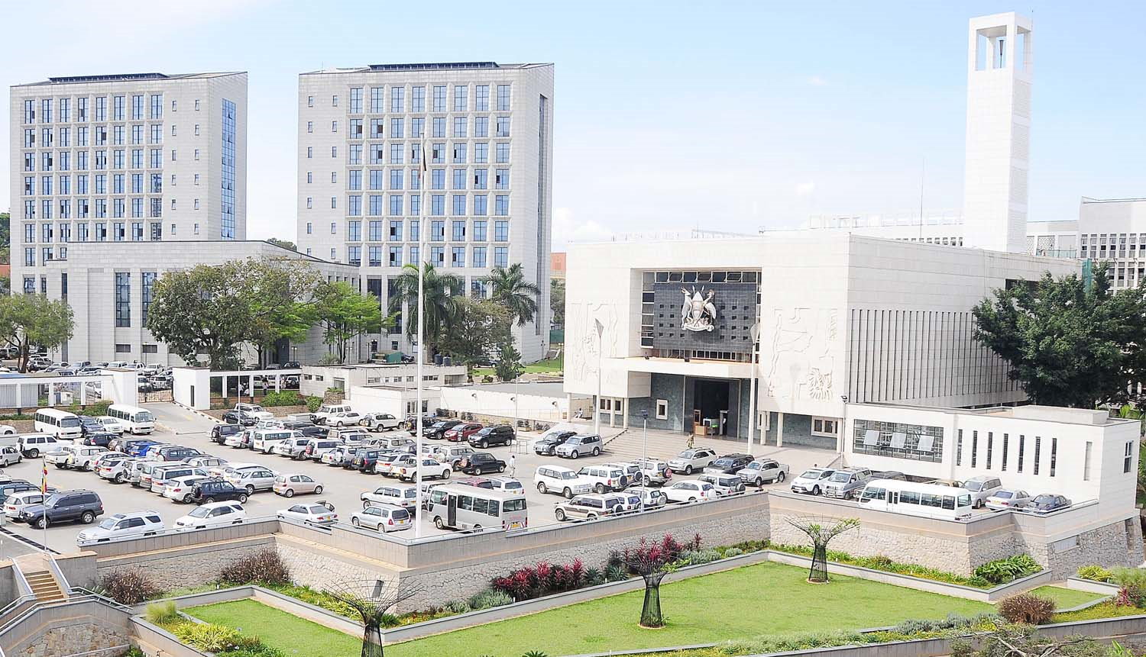
Highlights of Uganda Parliament
Vision:“A transformed, independent and people-centered Parliament”
Mission:“To achieve improved accountability, representation, democracy and good governance for sustainable development in Uganda”
Values: Integrity, professionalism, knowledge-based, efficiency, citizenry empowerment
Unicameral, 10th Parliament
459MPs (35%) Female.

Slide 4
Evaluating Parliaments
According to IPU (2008), a democratic Parliament is one that is:
Representative of the political will and social diversity of the population
Is effective in its- legislative, oversight and representative functions at national and international level.

Slide 5
Key Question
What counts as a good standard for evaluating effectiveness of Parliament?

Slide 6
Proposed Tools/Frameworks
Parliamentary Report Card (The Parliamentary Centre & World Bank Institute, 2003)
Parliamentary Standards for Democratic Legislatures (World Bank Institute, 2004)
Recommended Benchmarks for Democratic Legislatures (Commonwealth Parliamentary Association,2006).
Evaluation Parliaments: The Self-Assessment toolkit (Inter-Parliamentary Union, 2008)

Slide 7
The IPU Self-Assessment Toolkit
The IPU's toolkit draws extensively from International Institute for Democracy and Electoral Assistance (IDEA)’s State of Democracy Assessment methodology, which has been used to conduct citizen assessments of democracy in several countries.
-IPU, 2008

Slide 8
Objectives of IPU Self-Assessment Toolkit
To evaluate the legislature against international criteria for democratic Parliaments;
To identify priorities and means for strengthening Parliament.

Slide 9
When to use the Toolkit
It is up to each parliament to decide when and how to engage in self-assessment.
However, there are certain times in the life of a parliament that may be particularly opportune for conducting this exercise.

Slide 10
Scenarios for using the Toolkit
To help prepare the parliamentary budget and strategic plan
To stimulate a Parliamentary reform process
To promote gender sensitivity in Parliament
To enable new members of Parliament to discuss key issues
To validate the findings of a needs-assessment mission
To make an NGO assessment of Parliament

Slide 11
Topics/Dimensions of the Toolkit
The representativeness of Parliament
Parliamentary oversight on the Executive
Parliament’s legislative capacity
Transparency and accessibility of Parliament
The accountability of Parliament
Parliament’s involvement in international policy.

Slide 12
Standardization Process of IPU Toolkit in Uganda

Slide 13
Standardization Process …..
On 5th April, 2012, a planning meeting was held during the 126th IPU Assembly held in Kampala to discuss ways in which the institution of Parliament can be strengthened.
An IPU mission to the Parliament of Uganda, in cooperation with the Westminster Foundation for Democracy (WFD), facilitated the use of the IPU self-assessment toolkit for Parliaments.
The mission took place from 13 to 18 May 2012. Both Members and Staff participated in the assessment sessions.

Slide 14
Standardization Process…
The workshop used the following approach:
Sensitization of participants on self-assessments for parliaments specifically using the IPU self-assessment toolkit;
Pilot of the self-assessment of the Parliament of Uganda;
Set-up of a technical committee to domesticate self-assessment tool for the Ugandan Parliament.

Slide 15
Resources and documents used
Evaluating Parliament: a self assessment toolkit for Parliament-IPU (2008).
Field-testing of parliamentary scorecard indicators: toward a methodology for measuring parliamentary effectiveness and the ranking of African Parliaments- Jeewan Ramlugun (2011)
Parliamentary assessment: an analysis of existing frameworks & application to selected countries –World Bank Institute (2009)

Slide 16
Resources…Cont…
Gender-Sensitive Parliaments: A Global Review of Good Practice- IPU 2012
Benchmarks and Self-Assessment Frameworks for Democratic Legislatures
A Background Publication prepared for the International Conference on Benchmarking and Self-Assessment for Democratic Legislatures-UNDP 2010.
Recommended benchmarks for democratic legislatures- CPA.

Slide 17
Scenario Building-Pilot
There are several key questions before the self-assessment is conducted:
What is the purpose of the self-assessment? Does everyone involved share the same understanding?
What is the expected outcome of the exercise?
Who will participate in the self-assessment? Does the group represent a broad range of perspectives-internal and external?
What outcome documents will be produced? How will they be used? To whom and how will they be disseminated?
Have sufficient resources been allocated to the self-assessment?
Has a realistic timeframe been established for the exercise?

Slide 18
Pilot Results
Purpose
Profile of Parliament and track the changes in Parliament over time.
Outcome
An Assessment Report, analyzing strengths weaknesses of parliament, and agreed priorities (policy and developmental) for strategic planning
Participants
Commissioners, Party Whips, Committee Chairs and Vice-Chairs, Heads of departments and Senior staff of Parliament.

Slide 19
Pilot Results
Public involvement
External actors could possibly be invited in participate in future for example development partners, CSOs, media.
Outcome Dissemination
Executive summary to be shared with a wide public audience.
Coordination
Corporate Planning and Strategy Department
Inform the development of the next strategic plan for parliament

Slide 20
Response…
Financing
Parliamentary Commission through the Dept. of Corporate Planning and Strategy
Period
Review of tool
Mid way of the term of Parliament (2 and a half years)
Within the first month of the end of Parliament session.

Slide 21

Additional two (2) topics for Uganda context
Parliament and the budget process;
Parliament and gender

Slide 22

Uganda Parliament Approach to the assessment
Within a month after Parliament session.
A seminar /workshop approach for 1-3 days to ensure full participation.
  Day 1-Self assessment (review a checklist of issues that would have been set)
  Day 2- Gaps analysis
  Day 3-Way forward

Slide 23
REVIEW PROCESS
2nd Assessment held on the 19th September, 2018
Participants comprised of MPs and senior staff of Parliament.
Methodology of scoring:
 | 5 | 4 | 3 | 2 | 1
Q 1.1
Q 1.2
Q 1.3
Q 1.4
Q 1.5
5 = very high/very good
4 = high/good
3 = medium
2 = low/poor
1 = very low/very poor

Slide 24
Layout of the Toolkit..Gender topic
The gender subject in the Parliament of Uganda
7.1 How many women are there in Ugandan Parliament?
7.2 How many of these women hold leadership positions? (Speaker, Ministers, Committee chairpersons, vice chairpersons, Whips and for a leaders)
7.3 Are there laws that support gender equality in the parliament of Uganda? Does the Ugandan Parliament have gender equality objectives and gender equality plan of action? Are workplace policies in tune with men and women’s realities?
7.4 Are gender considerations integral to the work of parliament?
7.5 Are there facilities suited for men and women in the Uganda parliament?
7.6 How gender sensitive are political parties?
7.7 Additional question:
 | 5 | 4 | 3 | 2 | 1
Q7.1
Q7.2
Q7.3
Q7.4
Q7.5
Q7.6
Q7.7
5 = very high/very good
4 = high/good
3 = medium
2 = low/poor
1 = very low/very poor
What has been the biggest recent improvement in the above?
What is the most serious ongoing deficiency?
What measures would be needed to remedy this deficiency?

Slide 25
Presentation of results- Representativeness of Parliament

Slide 26
RECENT IMPROVEMENTS | ONGOING DEFICIENCY
Composition from the entire country Special interest groups representation Multiparty dispensation Strengthened office of the Leader of Opposition | Marginalized groups not fully represented in Parliament Limitations of space and budget amidst an ever growing Parliament Inadequate time for debate during plenary Unchecked political party caucusing impacting negatively on the independence of parliament Commercialization of politics: the cost of someone being elected a member of parliament is very high. Limited MPs in the vetting of presidential nominees
REMEDIES FOR IMPROVEMENT
In-depth assessment of interest and marginalized group representation in Parliament Review the growing number of MPs and the impact on resources-constitutional amendments Prior registration of members who would wish to debate to allot adequate time to debate during plenary. Political party funding to fund to research and develop alternative policy positions outside party influence The rules of procedure be reviewed make vetting process open to the public.

Slide 27
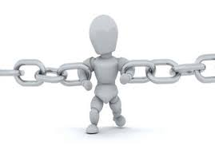
What remains to be done
Incorporate assessment in the parliamentary calendar
Linking results with the strategic plan.
Develop tools that will be used to monitor and evaluate the process.

Slide 28
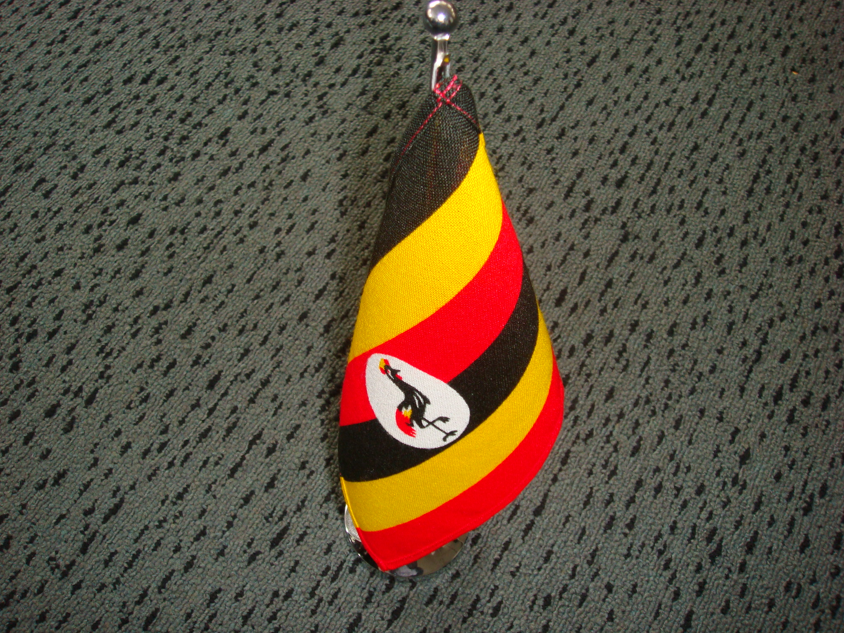
Thank You
“For God and my
Country”
Email :waterajosephine@yahoo.com
Cell: +256776123523

