Slide 1
USAID/ UGANDA SCHOOL HEALTH AND READING PROGRAM
Moving the Needle on Reading Achievement in Uganda:
Early Grade Reading Assessment Results
Presentation to Uganda Evaluation Week Conference
February 2019

Slide 2
Importance of Local Language Literacy
Learning to read involves understanding the relationships between symbols, sounds, words and meanings
Learners can master these reading skills more easily when they are first taught in a language that has meaning to them – one they hear at home
Learners can then translate these
Reading skills to learn
Another language,
such as English
“Em-bwa”
Dog
Embwa
Notes:
Learning to read in any language requires learners to first understand the relationship between letter symbols and their correlated sounds. Research shows that the level of proficiency to which teachers develop the ability to teach these sound-symbol and symbol-meaning relationships and learners’ ability to understand them is improved when literacy is taught in local area language. This is because the child already knows how to speak the language, and has prior understanding of the words created by symbols strung together when he or she hears them. Conversely, imagine sounding out a word, but you have no idea what it means, or what any of the words around it mean. When a local area language is used as the medium of instruction, it also becomes easier for teachers to evaluate how well learners’ are able to master a reading skill, because teachers also have an inherent understanding of the sound-symbol relationships and can pick up if learners are having difficulty more quickly than in a second language, such as English.
Just as learners have an easier time developing reading skills in local language or mother tongue, a large body of evidence indicates that when children learn to read in a second language (in this case English) through their first language, they are not only able to transfer foundational reading skills, but also learn to read in the second language through higher level communication and discussion, rather than rote memorization The relationship between learning to read in local language or mother tongue and a second language is further supported by Cummins’ “interdependence” hypothesis, which states that attaining reading proficiency in a second language depends in part on the level of proficiency a learner has developed in his or her first language.
Adams, Marilyn J. 1990. Beginning to Read: Thinking and Learning about Print.Cambridge, MA: MIT Press.
Diaz, J.C. 1999. Bilingualism, biliteracy and beyond. In: Diaz, J.C. (Ed.), Bilingualism: Building Blocks for Biliteracy. Language Acquisition Research Centre, University of Western Sydney, Sydney.
Altinyelken, et al. (2014)
Altinyelken, et al. (2014)
Cummins, 1993

Slide 3
Local Language Instruction in Uganda
1992
White Paper recommends use of Local Language for P1 to P3 instruction
2007
NCDC introduces the Thematic Curriculum, institutionalizing LL instruction
2012
Inception of the USAID funded USAID/Uganda School Health and Reading Program
EARLY CHALLENGES
Urban Schools
Testing in English
Disputed Orthographies
Notes:
For over 60 years, the Government of Uganda has promoted local language education. According to Article 6 of the Constitution, languages other than English may be used as a medium of instruction in schools or other educational institutions or for legislative, administrative and judicial purposes. Based on the recommendations of the White Paper on education of 1992, the government adopted the use of mother tongue as a medium of instruction in all education programs from Primary 1 to Primary 3.
In 2007, The National Curriculum Development Centre (NCDC) introduced the Thematic Curriculum which reemphasized the use of local language as a medium of instruction in the early grades, progressively increasing teaching in English until P4 when English would be the predominant language of instruction. At this time, the focus was on nine local languages: Luganda, Lhukonzo, Ngakarimojong, Runyankore-Rukiga, Runyoro-Rutooro, Lugbarati, Ateso, Lusoga and LebAcoli.
Currently, over 30 indigenous languages are being used as medium of instruction at the primary level. All of Uganda’s rural schools must choose a dominant local language as the language of learning and teaching for the first three years of primary school before making the transition to English. There are exceptions, including urban government schools, as the policy assumes that their learners are drawn from different parts of the country and therefore from multiple linguistic backgrounds. These schools use predominantly English as their medium of instruction but must teach a local language as a subject. There is, however, a lack of clarity around what constitutes an “urban” school and where this exception might apply. Selecting a local language is also not always obvious (as we will discuss below). Upon returning from field visits as part of the annual sector review, Ministry of Education officials commented that, even after a visit, it was unclear what the official school language was.
Operationalizing the Local Area Language Policy: Identifying the local area language of the school is one of many challenges in operationalizing this policy. Other challenges include non-existent, disputed or untested orthographies in many of the languages, a lack of reading materials in these languages, and, simply put, lack of experience in reading in these languages (opposed to speaking) on the part of the teachers and teacher trainers. Community and parental opposition to learning in the local languages also exists as there is a belief that good quality schooling is synonymous with schooling in English as is the way in prominent private schools. Furthermore, examinations are often set in English for all grades. This includes the high stakes Grade 7 Primary Leaving Exam which selects students for secondary school and also ranks schools nationwide (making headline news) and the National Assessment for Progress In Education (NAPE) which assesses system progress in Primary 3 and Primary 6 and is used to gage national and district progress in primary education.
Ssekamwa, J.C (1997, P. 131): History and Development of Education in Uganda
Government White Paper (1992): Education for National Integration and Development, Kampala P. 16-17.

Slide 4
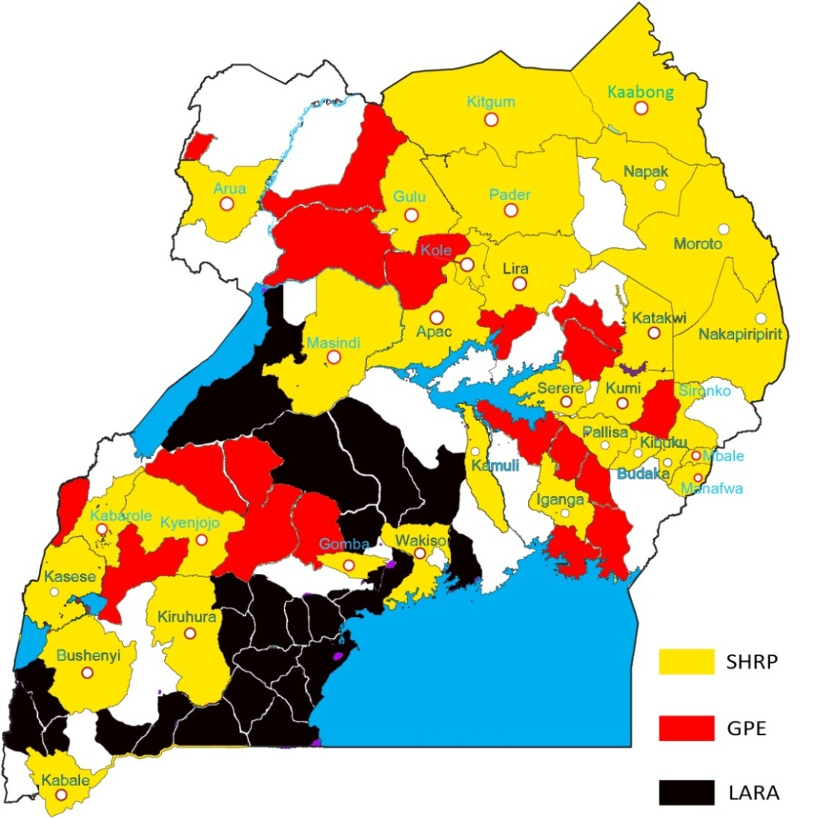
Early Grade Reading Programs in Uganda
SCHOOL HEALTH AND READING PROGRAM
37 DISTRICTS
3,761 schools
LITERACY ACHIEVEMENT AND RETENTION ACTIVITY
29 DISTRICTS
3,402 schools (overall)
UGANDA TEACHER AND SCHOOL EFFECTIVENESS PROJECT (UTSEP)
27 DISTRICTS
~2,644 schools
GPE FUNDED
MOESTS IMPLEMENTED
Build Africa
Notes:
Between SHRP (31 districts), LARA (28 districts), and UTSETP (27 districts), 88 out of 114 districts will be covered by early grade ready program established by school health reading program.

Slide 5
EGR Approach: The 5 T’s
TIME for reading every day
Teachers are trained in best TEACHING practices in early grades reading and provided regular monitoring and support.
Appropriate Text for learners in both LL and English.
Children learn to read faster and better first in their Mother Tongue and then transition to English.
Testing- EGRA used to measure progress toward learning to read and teachers continually assess reading skills (learner check)

Slide 6
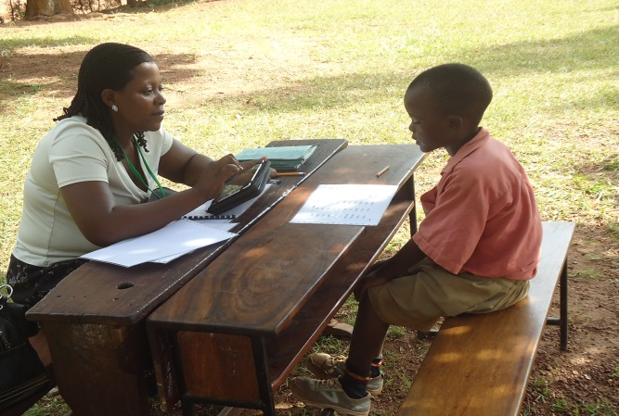
Testing: Early Grades Reading Assessment
Early Grade Reading Assessment is used to measure children’s progress toward learning to read

Slide 7
EGRA Methodology
14 schools randomly selected for treatment and 14 for control in each language
40 P1-P4 pupils randomly sampled at each school (20 M 20 F)
1 on 1 oral assessment
Approx. 15 minutes per language
Notes:
Fourteen schools in each language were selected randomly for both treatment and control groups. At each school, 40 P1-P4 pupils are randomly sampled with equal numbers of boys and girls selected. Since the initial baseline data collection in 2013, SHRP has conducted over 34,500 EGRA assessments in 34 districts throughout all regions of Uganda. After learner data is collected electronically using Tangerine software, it is cleaned and each subtask analyzed. This analysis of learners’ basic reading skills includes average correct letter sounds read per minute, average correct words read per minute, percentage of learners reading over 20 words per minute, and average number of reading comprehension questions answered correctly.
The EGRA assessment also includes interviews with learners (focusing on other social economic factors that might affect learning), teachers and head teachers, as well as classroom lesson observations. Results from these analyses are compared to reading outcomes to help the program better understand environmental, systematic and pedagogical characteristics associated with improved reading performance.

Slide 8
EGRA Methodology
Intervention Clusters by Language and District
Cluster | Languages | Districts Receiving Intervention
Cluster 1 2013 | Ateso | Katakwi, Kumi, Serere
 | Leblango | Apac, Kole, Lira
 | Luganda | Gomba, Wakiso
 | Runyankore-Rukiga | Bushenyi, Kabale, Kiruhura
Cluster 2 2014 | Leb Acoli | Gulu, Kitgum, Pader
 | Lugbarati | Arua
 | Lumasaaba | Mbale, Manafwa, Sironko
 | Runyoro-Rutooro | Kabarole, Kyenjojo, Masindi
Cluster 3 2015 | Lhukonzo | Kasese
 | Lugwere | Budaka, Kibuku, Pallisa
 | Lusoga | Iganga, Kamuli
 | Ngakarimojong | Moroto, Kaabong Nakapiripirit, Napak
Large Scale Randomized Control Trial
using Early Grades Reading Assessment
Adapted for 12 local languages (and English)
Subtasks test foundational reading skills
Alphabetic Principal
Phonemic Awareness
Listening Comprehension
Reading Comprehension
Vocabulary
To date, over 34,500 EGRA Assessments conducted
Notes:
The Early Grade Reading Assessment (EGRA) is a mixed methods evaluation tool that tests learners’ understanding of and ability to use foundational reading skills. Different subtasks test different skills, including alphabetic principal, phonemic awareness, reading fluency, comprehension, and vocabulary. Learners are tested in their local area language and in English. EGRA was adapted to each local language during week long workshops held with local language experts, district education officials and practicing lower primary school teachers. The assessment takes roughly 15 minutes per language and is administered orally in a one-on-one setting. For each data collection activity, inter-rater reliability (IRR) tests were conducted with assessors in English and each local language. Assessors in all languages scored an IRR over 90%.
EGRA data collected in Uganda is used to determine the impact of SHRP interventions and to inform both the program’s technical activities (including teacher training and in-service teacher support) and Ministry- and District- level policies and programming. Intervention schools are grouped by language into three “clusters”, based on a number of factors including each orthography’s existing level of standardization at the start of the program. Table 1 (above) provides a breakdown of each cluster by language and district. Clusters began receiving the interventions in one year intervals, beginning in 2013. For each cluster, , baseline data are collected at the beginning of Primary 1 in program and control schools, and then data are collected at the end of every school year after (end of P1, end of P2, end of P3 and end of P4)

Slide 9
EGRA Methodology
Intervention Clusters by Language and District
Cluster | Languages | Districts Receiving Intervention
Cluster 1 2013 | Ateso | Katakwi, Kumi, Serere
 | Leblango | Apac, Kole, Lira
 | Luganda | Gomba, Wakiso
 | Runyankore-Rukiga | Bushenyi, Kabale, Kiruhura
Cluster 2 2014 | Leb Acoli | Gulu, Kitgum, Pader
 | Lugbarati | Arua
 | Lumasaaba | Mbale, Manafwa, Sironko
 | Runyoro-Rutooro | Kabarole, Kyenjojo, Masindi
Cluster 3 2015 | Lhukonzo | Kasese
 | Lugwere | Budaka, Kibuku, Pallisa
 | Lusoga | Iganga, Kamuli
 | Ngakarimojong | Moroto, Kaabong Nakapiripirit, Napak
Large Scale Randomized Control Trial
using Early Grades Reading Assessment
Adapted for 12 local languages (and English)
Subtasks test foundational reading skills
Alphabetic Principal
Phonemic Awareness
Listening Comprehension
Reading Comprehension
Vocabulary
To date, over 34,500 EGRA Assessments conducted
Notes:
The Early Grade Reading Assessment (EGRA) is a mixed methods evaluation tool that tests learners’ understanding of and ability to use foundational reading skills. Different subtasks test different skills, including alphabetic principal, phonemic awareness, reading fluency, comprehension, and vocabulary. Learners are tested in their local area language and in English. EGRA was adapted to each local language during week long workshops held with local language experts, district education officials and practicing lower primary school teachers. The assessment takes roughly 15 minutes per language and is administered orally in a one-on-one setting. For each data collection activity, inter-rater reliability (IRR) tests were conducted with assessors in English and each local language. Assessors in all languages scored an IRR over 90%.
EGRA data collected in Uganda is used to determine the impact of SHRP interventions and to inform both the program’s technical activities (including teacher training and in-service teacher support) and Ministry- and District- level policies and programming. Intervention schools are grouped by language into three “clusters”, based on a number of factors including each orthography’s existing level of standardization at the start of the program. Table 1 (above) provides a breakdown of each cluster by language and district. Clusters began receiving the interventions in one year intervals, beginning in 2013. For each cluster, , baseline data are collected at the beginning of Primary 1 in program and control schools, and then data are collected at the end of every school year after (end of P1, end of P2, end of P3 and end of P4)

Slide 10
What does EGRA measure?
EGRA measures basic skills that a child must have to be able to read fluently with comprehension- The Five Components of Literacy!
Reading Skill | Demonstrated via:
Alphabetic principle | Provide SOUND of letters Sound out or read non-words
Phonemic awareness | Segment words into sounds or syllables
Oral reading fluency | Read a passage (with speed and accuracy)
Reading comprehension | Answer questions about passage
Vocabulary | Point to body parts, objects & show direction

Slide 11
Research Questions
Research Questions
Is reading achievement increasing in School Health and Reading Program Schools?
Are teachers changing the way they teach reading?
Are teachers being supported in the classroom?

Slide 15
Reading comprehension, though higher than control for some language areas, is still low due to low levels of English comprehension (learners are decoding words, but do not understand enough to be able to answer questions).
Reading comprehension in the local language is significantly higher in program compared to control in all but Leblango, and much higher than English reading comprehension.

Slide 16
Major “take away” messages from EGRA results in Uganda
When children learn to read (decode) in their local language, they are able to transfer this skill to decoding English. However, more work needs to be done to improve English comprehension.
Although SHRP has been able to move more learners to higher reading levels and they are on their way to becoming fluent readers, there are still too many learners not acquiring foundation skills.
It takes more time to move children from the zero than anticipated but when they move beyond, the gains take off as can be seen from P3 onwards.
Reading gains in large scale interventions take time due to systemic and contextual challenges
It is important to continually change and adapt the programs to the reality on the ground.
Notes:
(Ugandan children start at a comparatively low level, pupil and teacher absenteeism-highest in the region; limited teacher support. )

