Slide 1
Inculcating a political will to execute evidence-based decision making by Parliament of South Africa and the Executive: A case of student funding in the post-school education and training
MAMPHAGO MODIBA, CONTENT ADVISOR, PARLIAMENT OF THE OF SOUTH AFRICA,
11- 15 FEBRUARY 2019, 7TH UGANDAN EVALUATION WEEK, KAMPALA, UGANDA

Slide 2
Table of contents
Introduction
Constitutional mandate of Parliament and the Committee and instruments for oversights
Policy priorities of the Ruling Party (African National Congress) and Government.
Was there a political will to implement policy decisions?
Gap years
What did the evidence show?
Forcing the hand of Parliament and the Executive to take evidence-based decision
#FeesMustFall Movement
Counting the losses
Forced “political will”
Lessons learnt and conclusion

Slide 3
1. INTRODUCTION AND BACKGROUND
The Parliament of South Africa through the Portfolio Committee on Higher Education and Training assesses the country’s Department of Education’s service delivery performance
given available resources;
an assessment on the effectiveness and efficiency of the departments use and allocation of available resources; and
may include recommendations on the forward use of resources.
The Committee does its work through evidence-based approach.
The political will of both parliamentarians and the Executive sometimes goes against the evidence due to conflicting national priorities.
The funding of higher education in South Africa is the best example of how ignoring evidence-based oversight culminates in an unintended consequences for both the state and the general citizenry.

Slide 4
3. Constitutional mandate of Parliament and the Portfolio Committee
Section 55 empowers the National Assembly to:
S55(1)
consider, pass, amend or reject any legislation before the Assembly;
Initiate or prepare legislation, except Money Bills
S55(2)
to provide for mechanisms (a) to ensure that all executive organs of state in the national sphere of governmental are accountable to it;
to maintain oversight of (i) national executive authority, including the implementation of the legislation; and (ii) any organ of state”.

Slide 5
Instruments of oversights
Constitution
Legislation
Government programme of action (MTSF five-year plan)
Questions (written and oral) – President, Deputy-President, Ministers
Members’ statements (Members and Ministers)
Debates in the House
Matters from constituency work
Annual reports
Budget speech
Reports from the auditor-General
Medium-Term Budget Policy Statement (MTBPS)
Estimates of National Expenditure
Private Member’s bills
Individual Member’s bills

Slide 6
Policy priorities of the Ruling Party (African National Congress) and Government.
52nd and 53rd National Conference of the African National Congress (2007 and 2012)
National Development Plan (NDP) vision 2030, adopted in 2011
Medium Term Strategic Framework 2014 2019
2011 & 2015 ANC Lekgotla
Implement fee –free higher education for the poor in South Africa
Academically capable students from poor families should not be expected to pay up-front fees in order to access higher education
To provide all students who qualify for NSFAS with access to full cost of study through loans and bursaries to cover the costs of tuition, books, accommodation and other living expenses.
A newly structured national student financial aid system must be introduced to enable fee–free education from 2014 onwards.
Examining extending of free education to cover students in other years and covering full cost of study for poor in scarce skills areas
Finalisation of a policy on Fee-Free Higher Education for poor students at undergraduate level as a matter of urgency.

Slide 7
Was there a political will to implement policy decisions?
SONA 2011 Conversion of loans of the final year of study (President J Zuma)
The conversion of loans to bursaries to be implemented for the other years of study as an introduction of fee free education
This never implemented for the years of study
R200 million has been provided to enable NSFAS to grant loans to students who have completed their studies but have not received their certificates or graduated, due to outstanding debt. (Minister Nzimande, 2012)
R350 million for poor continuing students who were unable to register due to outstanding debt and insufficient funding in 2012. (Minister Nzimande, 2013)
Acknowledgement of student funding shortfall

Slide 8
2012 Report of the Working Group (WG) on Fee-Free University Education for the poor in SA
The Minister established the WG in March 2012 to investigate, and advise on the feasibility of making university education fee-free for the poor in South Africa, (DHET, 2012)
This was necessitated by calls for the introduction of fee-free access policies for poor students from student political organisations and political parties, including the ruing party (ANC).
The WG was tasked to determine the actual cost of introducing fee-free HE for poor in SA;
Suggest a working definition of poor people in SA, if necessary suggesting different categories and how all can be provided fee-free HE;
Examine various model and options of providing fee-free HE for poor people used elsewhere in the world and make recommendations to the Minister, and
Contemplate all possible implications and consequences of providing fee-free HE for the poor.

Slide 9
Findings and recommendations of the WG
The WG found that free university education for the poor in SA was feasible, but would require significant additional funding of both the NSFAS and university system and recommended that:
Free full cost of study undergraduate university education for the poor in SA should be introduced using the current NSFAS structure and basis, but refining these over time, and simultaneously ensuring that corporate governance, fund management procedures and loan recovery practices at NSFAS were completely overhauled and rendered above reproach.
Funding for free education for the poor should be derived at least in par from a proportion of the Sector Education and Training Authorities funds set aside by both the private and the public sectors for skills development, and earmarked to provide for sustainable NSFAS-administered income-contingent loans to poor students in identified scarce-skills sectors.
(DHET, 2012)

Slide 10
Announcement by the Minister of HET on the WG Report, 2013 Budget Speech
The Minister announced that he had received a report from the WG on fee-free university education and he was studying its recommendations and preparing a submission to Cabinet to implement the African National Congress (ANC) Mangaung Conference resolution to phase in fee-free education.
With regard to funding more broadly, he had received a comprehensive report from the Ministerial Committee on the Review of Funding of Universities which would be published soon. The Department would model the various recommendations and develop a revised funding framework before the end of the 2013 financial year.

Slide 11
Gap years
Government
Students voices growing louder
Universities
Deafening silence on funding and implementation of fee-free HE between 2013-2015;
No feedback on the implementation of fee free HE;
Inadequate funding allocation for both universities and NSFAS continued
Financial exclusions;
Unaffordable HE fees;
Missing middle funding
Historic debt;
Shortage of student housing;
Partial funding;
Implementation of fee-free HE;
Scrapping of registration fees
Inadequate funding from government;
Dwindling university financial reserves;
Rising student debt;
Financial health of universities compromised;
Shortage of student accommodation;
Initiatives by universities to engage government, even the President;
Parliament facilitating conversations and policy direction

Slide 12
What did the evidence show (2012/13 – 2015/16)?
Both evidence gathered and reported by the Parliamentary Portfolio Committee on Higher Education and Training (4th and 5th Parliament) had shown over several years that funding allocated to the National Student Financial Aid Scheme (NSFAS) was inadequate.
Despite the growth in the allocation, the need for financial aid far outstripped the available funds and some students could not be funded at all while some others received funding, however, not all the cost of study could be funded.
Despite increase in funding, from R440 million in 1999 to R9 billion in 2014, demand for financial aid exceeds supply. 50% of eligible students were unfunded
The partially funded students were left with outstanding debts and some universities implemented policies which financially excluded students who owed.
Findings from the oversight visits since 2010, have shown that students debts at universities was growing due to outstanding students payments.

Slide 13
Conti….
Students protests increased across higher education institutions even where the new funding model was piloted;
The target of the Department and NSFAS to fund 205 000 students from 1.1 million student enrolment planned for 2015/16 in higher education was inadequate to expand access of poor students and to redressing the legacies of the past
Recommendations
The Minister of Finance should realistically increase the budget of the National Student Financial Aid Scheme over the medium term to enable all academically capable, but financially needy students to access higher education and technical vocational education and training and to cover full cost of study through loans bursaries as proposed in the NDP; and to accommodate incremental growth in student enrolment through the new universities and the envisaged 12 new TVET college campuses.
The Department should explore the possibility of reviewing the cost drivers of university education to minimise and regulate fee increment by universities.
NSFAS should improve its allocation of funds to institutions and support institutions that have challenges in submitting their claims timeously.

Slide 14
The Committee recommended that:
A funding strategy of NSFAS should be submitted to the Portfolio Committee within 7 working days.
The Department should undertake a comprehensive review of student indebtedness in higher education to determine its root causes and possible solutions.
NSFAS funding for TVET college bursaries had been increasing on consumer price index (CPI). The Department targeted to cover at least 80 percent of college students with NSFAS bursaries, however, the investment of R2.4 billion for 2016/17 was insufficient, taking into account the NDP and White Paper targets.

Slide 15
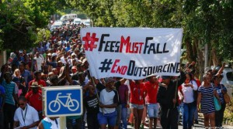
Forcing the hand of Parliament and the Executive to take evidence-based decision
At the beginning of 2015 as it was norm in many universities, students protested against financial exclusions.
Majority of students incurred outstanding debts due to been funded partially through NSFAS;
Universities required payment of outstanding debts before students could be allowed to register and this left many students who were academically deserving financially excluded;
In October 2015, protests started at WITS university sparked by proposed 10.6% fee increase for 2016 academic year;
The protests quickly spread to other institutions that announced the 2016 fee increases;
A national shut down under the #FeesMustFall movement was declared.
Students protesting against fee increases and outsourcing at Wits University,
Source: Socialist Alternative (2015)

Slide 16
#FeesMustFall Movement
Apolitical movement
Across political party lines
Supported universities and some groups of academia
Supported by some political parties and figures
The principle endorsed by general citizenry
Targeted at strategic government national key points (Parliament, Union Buildings, city halls)

Slide 17
#FeesMustFall movement demands
2015/16
2016/17
2017/18
Zero per cent fee increase for the 2016 academic year;
Historical debt of NSFAS funded students to be addressed;
Insourcing of staff for outsourced services;
Implementation of fee-free quality education in their life time; and
Decolonisation of curriculum and transformation in higher education
De-militarisation of university campuses;
Release of the report of the Commission of inquiry into higher education funding;
Release of students who were arrested during earlier protests;
Insourcing of staff (mostly cleaners, gardeners and security);
Funding for the missing middle
Individual institutions:
Removal of private security on campus;
Legal cases against arrested students to be dropped;
Suspension of students to be lifted;
Insourcing;
Cancellation of students debt;
Student accommodation; and
Decolonisation of higher education curriculum

Slide 18
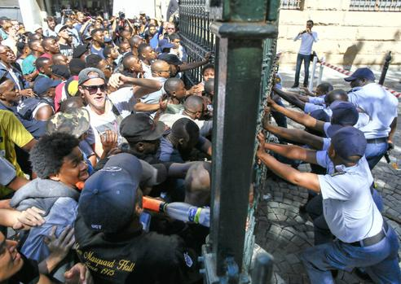
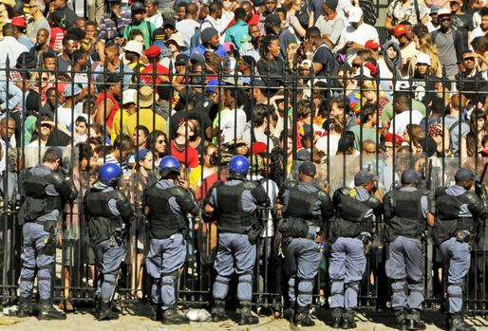
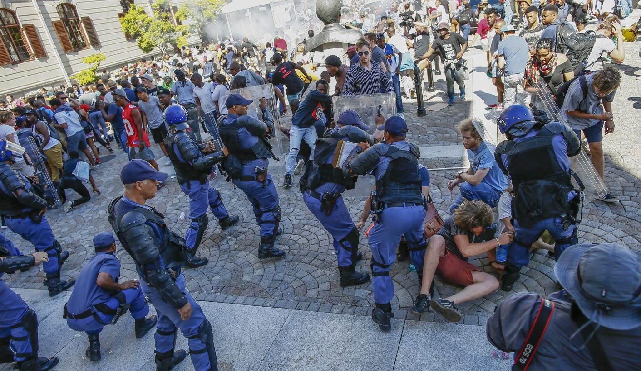
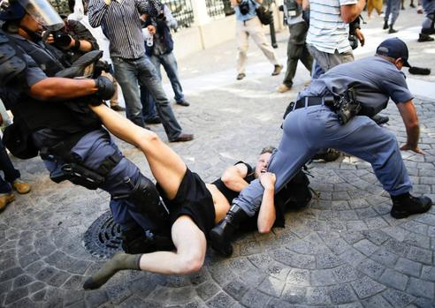
Student protesters march to the Legislature/ Parliament
Protesters force their entry into Parliament Precincts
SA Riot Police uses force to push back against protesters

Slide 19
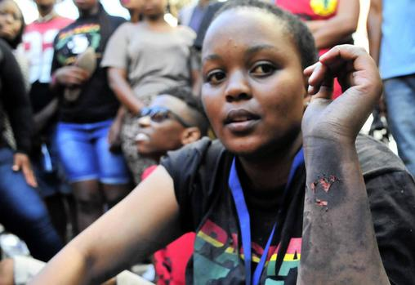
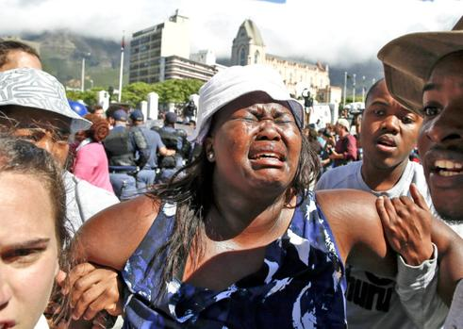
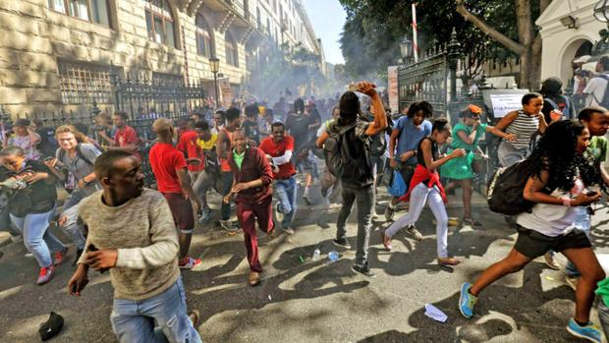
Students were prepare to lose life and limb for their course
By Marianne Merten, 22 October 2015, https://www.iol.co.za/news/riot-police-vs-student-power-1933836

Slide 20
Counting the losses
The 2015/2016 – 2017/18 #Fees Must Fall left a trail of damage at universities with the reported R786 million (R492.4 million : 2015/16; R237.7 million : 2016/17 and R56.5 million : 2017/18) cost of damage to university property.
Libraries (law library), computer laboratories (R100 million donated by the private sector, buses, cars, heritage statues and heritage paintings were some of the properties that were torched during the protests. Funding required to refurbish, rebuild and replace the damaged institutional and individual property could have been used to build new infrastructure that is needed by the universities, like students residences.
Intimidation of both staff and students during disruption of classes. Most of the staff members are still traumatised by the aggression displayed by protesting students.

Slide 21
South Africa has universities which are ranking high globally and they attract a large number of international students, academics and research collaborations, students and staff exchange programmes. Internationalisation is very crucial and is one of the criteria used during rankings of universities.
The protests had dented the global image of universities. University had to double their efforts to advocate and market their institutions.
Research projects at some universities could not be completed on time because researchers could not access the university precincts.
Some universities had to postpone 2016 November examinations to January 2017.
The increased cost of employing private security and additional security measures.

Slide 22
Forced “political will”
#FeesMustFall movement forced the political will of government and Parliament to implement policy decisions taken.
An urgent stakeholder engagement was convened by the President at the Union Building at the request of the universities Vice-Chancellors, 23 October 2015.
Decision announced by the President Zuma at the meeting:
A zero percent increase of university fees in 2016;
Examination period to be extended;
Further discussions on funding to continue, including institutional autonomy, transformation and students debts
2017 (Presidential pronouncement, 17 December)
Fully subsidized free higher education and training for the poor and working class SA undergraduate students starting in 2018 with students in their 1st year of study at public universities. Students defined as poor and working class will be funded and supported through government grants not loans.

Slide 23
Cont.….
Government spending on universities as per percentage of GDP will increase from 0.68% to 1% over the next five years.
NSFAS packages already allocated to existing NSFAS students in their further years of study will be converted from loans to 100% grants effectively immediately.
Grants for poor and working class SA students at universities and Colleges will continue to be managed and administered by NSFAS through the Student-Centred Model.
Historic Debt: Management of the historic debt will be dealt with by the Minister of Higher Education and Training after due diligence has been undertaken by the DHET; Department of Performance, Monitoring and Evaluation and National Treasury to determine the quantum of funding required.
2018: Implementation of fee free education

Slide 24
Lessons learnt and conclusion
Ignoring evidence-based policy decision making has long term effect to the state.
Political will manifesting through government priorities should always be evidenced-based.
Upholding the constitutional mandate is important for legislatures to inculcate trust among social partners.
Blurring of lines between Parliament and Executive leads to unnecessary conflicts in society.
Separation of powers should always be upheld regardless of whether the legislature and the Executive are comprised of the same political party.

Slide 25
References
African National Congress (2007) Resolution by the ANC 52nd National Conference, Polokwane, 20 December 2007, www.anc.org.za
African National Congress (2012) Resolution by the ANC 53rd National Conference, Mangaung, 20 December 2012, www.anc.org.za
Department of Higher Education and Training (2012) Report of the Working Group on fee-free university education for the poor in South Africa, October 2012, www.dhet.gov.za

