Slide 1
The role of Uganda Evaluation Association (UEA) in strengthening the quality of the National M&E System
By Isaac Senyonjo

Slide 2
Outline
The Strength, Weakness, Opportunities and Threats (SWOT) Analysis of UEA
The Strength, Weakness, Opportunities and Threats (SWOT) Analysis of the National M&E system in Uganda
The UEA strategies to strengthen the M& E system and the M&E society, the short term & long term future plans
A Comparison of the UEA and other National evaluation societies (NES) that attended the seminar in the context of their Startup and official recognition; Sources of funding, Human resources, Sectoral and membership composition
Information sharing

Slide 3
The SWOT Analysis of the UEA
Strength of the UEA
Established secretariat
Active executive committee
Availability of Evaluation standards
Forum for members Professional Development (NEK)
Membership subscription

Slide 4
Weakness of the UEA
Inadequate tangible benefits to members
Inadequate staff
Limited funding sources
Failure to operationalize evaluation standards
Limited visibility of UEA
Absence of board of Trustees to provide strategic direction to the executive

Slide 5
Opportunities to the UEA
Legally registered
Strong reputation among partners & worldwide
Fairly diverse membership from different sectors
Spirit of voluntarism
Strong support from Government (OPM)

Slide 6
Threats of the UEA
Limited involvement in influencing government policies
Missing working relationship with like-minded associations
Dependence on member’s voluntarism
Attrition/Transint of members

Slide 7
The SWOT Analysis of the National M&E system in Uganda
The Diagnosis was based on the checklist, developed from documents regarding the National M&E system in Uganda, which include: The National M&E policy and Plan, Documents illustrating the use of M&E outputs like the performance reports & a face to face discussion that was made with some officers at the OPM.

Slide 8
The checklist focused on the following topics
The M&E Policy
The Quality of Indicators, Data (collection) & Methodology
Organisation Structure, its linkage & capacity
Participation of Non-Government actors
M&E outputs; Quality and Use

Slide 9
Strength in the National M&E system
Existence of a comprehensive M&E policy & plan for MDAs
A functional linkage between the M&E coordinating entity & UBOS
An established system (PBS) of comparing the level of achievements against targets in MDAs
A culture of developing evaluation information products
Presence of oversight bodies that includes non state actors like Parliament, CSOs, DPs, etc.

Slide 10
Weaknesses the National M&E system
Uncoordinated evaluation sector methodologies i.e. each sector uses its own methodologies
Limited M&E capacity among public sector officers
Inadequate budget allocation for M&E activities
Absence of an integrated M&E capacity building plan
Weak mechanism to enforce evaluation recommendations among MDAs
Although the policy is clear on the role of parliament on M&E, their participation is limited

Slide 11
Opportunities in the National M&E system
Strong good will of Donors to finance M&E, mainly 3ie, DFID & UNDP
Emerging results based methodologies
Evidence driven policy making wave/trend globally
Increasing number of M&E training institutions
A CSO equipped with M&E skills and experience
GAPR structure to compel MDAs to give feedback on utilization of Evaluation recommendations

Slide 12
Threats of the National M&E system
Donor funding for evaluation is unpredictable in the sense that recipient sectors have no control over it
Parallel development of sector M&E framework
Complex design of the system (PBS) that is supposed to compare level of achievement against targets
Limited interest of parliament in M&E
Limited resources to operationalize the approved M&E structure in public sector

Slide 13
The UEA Strategies to strengthen the M&E system & UEA, short term & Long term strategies
UEA strategies
Conduct a stakeholder mapping
Review the UEA strategic plan
Standardize membership criteria with that of other NES
Operationalize the resource mobilization strategy
Up date members data base to capture expertise
Strengthen traineeship/internship and mentorship programs for YEEs

Slide 14
Strengthen the M&E system
Increase Supply of M&E
Strengthen stakeholders capacity
Network with academic institutions & professional bodies
Develop clear guidelines for engagement with the Donors and other Funding Agencies
Increasing Use
Develop an M&E communication strategy
Widely share GAPR recommendations for the data to reach all parts of the country
Further institutionalize M&E in all governance structures
Further strengthen an incentives system for integration of evaluation findings in programs
Further synchronisation of data collection and harmonisation with the UBOS in all sectors

Slide 15
Strengthen the M&E system
Increasing Demand
Strengthen citizen engagements (barazas)
Build capacity of outside government M&E actors (MPs, CSO, donors, media)
Promote structured engagement with CSO and government to participate in M&E events
Strengthen annual sector reviews
Further integrate M&E in all Gov`t programs

Slide 16
Future plans
Short term
Disseminate the SWOT to OPM & UEA members
Partner up with academic Institutions for evaluation journal
Medium term
Pursue a formal relationship with Gov`t (MOU, legal instrument)
Introduce a professional certification of members
Conduct national talks thru Webinars
Harmonisation of working relationships between the Auditor Generals Office, OPM, UBOS and UEA, so as to avoid inherent confusions and duplications of responsibilities.

Slide 17
COMPARISON OF UEA WITH OTHER NES
A Comparison of the UEA and other National evaluation societies (NES) that attended the seminar in the context of their Startup and official recognition; Sources of funding, Human resources, Sectoral and membership composition

Slide 18
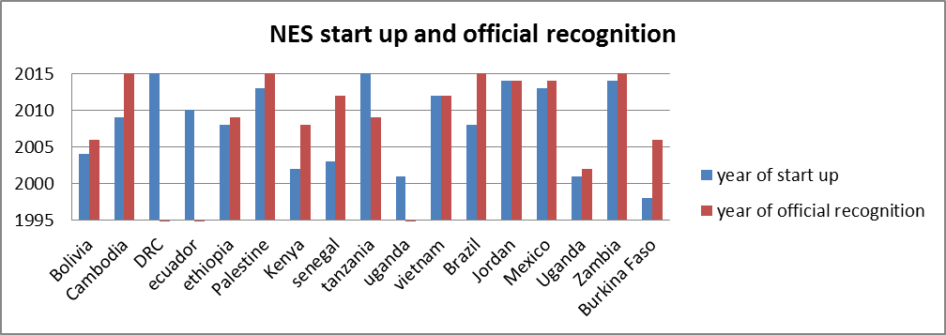
Bukina Faso and UEA were the oldest NES that attended the workshop; The UEA started in the year 2001 and officially recognition in 2002 & that of Bukina Faso started in the year 1997 & recognized in the year 2006

Slide 19
Figure 2: Sources of funding for NES

Slide 20
Figure 2: Human resources in NES

Slide 21
Percentage Proportion of Board membership to the UEA –Year 2017
 | Proportion
Number of board members in the year 2017 | 7
Proportion (%) of board members from government | 42. 9
Proportion (%) of board members from Parliament | 14.2
Proportion (%) of board members from civil society | 14.2
Proportion (%) of board members from donors | 0
Proportion (%) of board members from academia | 28.6
Proportion (%) of board members from private sector ( e.g. consultants) | 14.2
Overall Sectoral diversity board members(N sectors present among | 0

Slide 22
UEA MEMBERS
Number of official members in the year 2017 | 120
Number of informal members in the year 2017 | 461
Proportion (%) from government | 24.3
Proportion (%) from Parliament | 0.01
Proportion (%) from civil society | 16.7
Proportion (%) from donors | 0
Proportion (%) from academia | 3.6
Proportion (%) from private sector ( e.g. consultants) | 10.7
Overall sectoral diversity members (N sectors present among members) | 44.8
Number of participants in the last general assembly/ UEA meeting/ Open to all members | 89

Slide 23
COMPARISON with OTHER NES
 | Bolivia | Cambodia | DRC | ecuador | ethiopia | Palestine | Kenya | senegal | tanzania | uganda | vietnam
Number of official members | 25 | 35 | 0 | 50 | >100 | 23 | 100 | 359 | 300 | 120 | 0
Number of informal members | 120 | 61 | 0 | 50 | >100 | 17 | 200 | 62 | 150 | 461 | 0
Number of participants in the last G/ meeting | 16 | 0 | 0 | 30 | 57 | 9 | 25 | 34 | 0 | 89 | 0
Board members | 8 | 0 | 5 | 5 | 8 | 9 | 8 | 0 | 6 | 7 | 0

Slide 24
What sectors are missing? What sectors are over represented on the board? Is this a problem?
Does this kind of unbalanced representation pose challenges in the association? If yes what are the likely challenges?
There four, there are some Strengths from each sector, possible good practices and useful information we could share, to take the association to another level?

Slide 25
INFORMATION SHARING AMONG UEA MEMBERS We look at the Network of Key members ( based on the name generated by members of the evaluation) The focus was on the M&E related information sharing among the NES members Size of the nodes: the bigger the node, the more information they send to other members

Slide 26
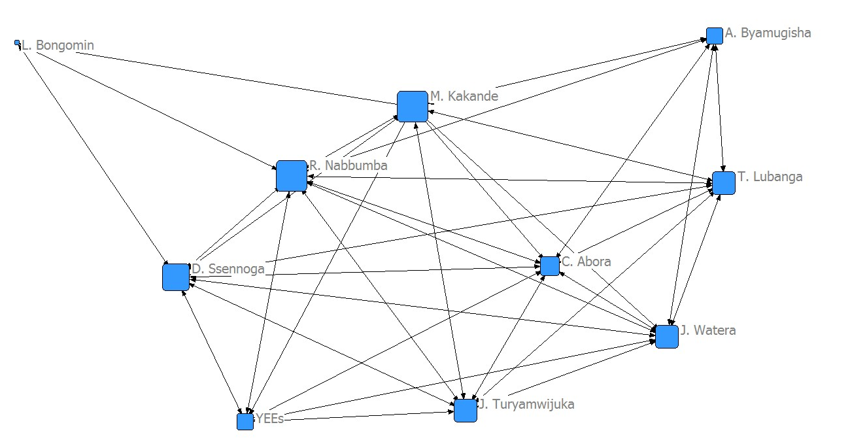
Information sharing network Cont

Slide 27
Information sharing networks cont
Do we Intensively share information?
Who’s central in information sending? Many/ few? Is it a vulnerable network ( if a key actor is no longer there, does the network fall apart?)
Is it efficient? Or are there many redundant ties?
Who are central in sending information? May/ Few? Are all sectors reached?

Slide 28
Information sharing networks cont
Sector perspective:
who is central in the network?
Are there biases to wards one or two sectors?
Which sectors are poorly represented? Are there ways to get other sectors more in the centre of the network?
Is there mostly inter- sectoral communication … i.e. gov communicating to government actors? Civil society to civil society? Is this problematic?
Is the sectoral network vulnerable? Are certain sectors cut off if a certain key actor is no longer in the network?

Slide 29
Information sharing network cont..
Recommendations
There is need to:
Identify accountability champions in all crucial sectors within UEA.
Identified core groups to identify the sectors that are missing

Slide 30
Activities Face to Face and Online activities
Does our UEA perform well in terms of:
Face to face activities? or
Online activities?
If not, is this a deliberate strategy? Do we focus more on one mode of interaction (face to face/ online)? What should we do more in the future?

Slide 31
Face to Face activities
 | Uganda
Face to face
Number of face to face meetings per year open to all members | 13
Number of face to face meetings of board members | 12
Number of workshops/ seminar/ learning activities per year | 14
Number of networking activities per year | 12
Number of awareness raising activities per year | 0

Slide 32
Online activities

Slide 33
Thank you

