Slide 1
Impact of Savings and Credit Cooperatives on Household Welfare in Uganda
Barnabas Kiiza (PhD)
George Omiat (PhD)
RESDEV CONSULT LTD
P.O. Box 10376 Kampala
Email: resdevconsult.ltd@gmail.com
abkiiza@gmail.com
gwomiat@gmail.com
Tel:+256-782-156-828

Slide 2
1.0 Introduction
Global poverty reduction is among key focus points of Sustainable Development Goals (SGDs).
Poverty reduction & improved access to financial markets by households are two very closely related phenomena.
Financial exclusion from traditional financial services is widespread in developing countries.
In Africa, less than 20% of households have access to formal credit (Beck et al., 2009).
In last 30 years microfinance emerged to address this gap.
Improved access to microfinance by HHs leads to increase & diversification of incomes; generation of human and social capital; as well as asset accumulation.

Slide 3
Introduction cont’d
Our study focuses on impact of Savings and Credit Cooperative Organizations (SACCOs) on welfare of member households in Uganda.
In Uganda, the government has encouraged the formation of SACCOs to increase outreach and access to financial services.
Estimates show by 2010 SACCOs in Uganda had:-
Outstanding loans of Shs 292 billion (US$132.73 million);
Net savings of Shs 208 billion (US$94.55 million);
Share capital of Shs 178 billion (US$80.91 million);
Income of Shs 60 billion (US$27.27 million).
By 2013 there were 1,900 operational SACCOs in Uganda.

Slide 4
Introduction cont’d
Objectives of a typical SACCO include:-
Promoting welfare & economic interests of members; providing savings & credit facilities at favorable interest rates; training members in business skills; poverty reduction and cooperation.
Importance and Challenges of SACCOs
SACCOs legally constituted, but not controlled by Central Bank were a second option to commercial banks by adults holding an account at a financial institution (EPRC, 2013).
61% of all users of SACCOs were women; 87% of all adult users of SACCOs were in rural areas of Uganda (EPRC, 2013).
Governance remains the major weakness of SACCOs in developing countries (including Uganda) (Labie & Périlleux, 2008; Cuevas & Fischer, 2006; Cornforth, 2004; B Branch & Baker, 2000)

Slide 5
2.0 Methodology
We evaluate impact of access to SACCO services on HH welfare by controlling for potential differences between the treatment & control cases using Propensity Score Matching method(PSM).
Sample restricted to HHs that use the services & actually save in SACCOs only (treatment cases);
Compare them with HHs that do not use the services nor save in in banks, microfinance institutions, SACCOs, etc (control cases).
Indicator variable for participation in SACCOs is D = 1 for participants and D = 0 for non-participants.
Observed mean outcome, Y under the condition of participation is given as E [Y₁ |D = 1].
Observed mean outcome, Y under the condition of non-participation , E [Y₀ |D = 0].
The Unobserved Counterfactual, E[Y₀ |D = 1].

Slide 6
Methodology cont’d
We want average treatment effect on the treated HHs (ATT) where ATT = E [Y₁ |D = 1] - E [Y₀ |D = 1] (For participants).
In practice we use Observed mean outcome for non-participants E[Y₀ |D = 0] to proxy Counterfactual outcome, E[Y₀ |D = 1].
We use PSM to match participants and non-participants in terms of observed characteristics, such as age, education, income, assets, etc, etc.
We estimate ATT = E [Y₁ |D = 1] - E [Y₀ |D = 0].
Treatment Effects Model
We also test whether participation in SACCOs is endogenous using Wu-Hausman test.
We find it’s endogenous and then use two-step treatment effects model that controls for hidden selection bias.

Slide 7
Treatment effects model uses the two step procedure with the participation first stage probit model as:-
D_{i} = β′x_{i} + γ′z_{i} + β_{λ}λ + v_{i}
The predicted values of probit model are used in the second stage OLS regression given by:
Y_{i} = β′x_{i} + β_{IV}D + ε_{i} (Outcome equation)
The Impact of Participation is given by coefficient β_{IV}
D = 1 for participants and D = 0 for non-participants
λ is the inverse Mills ratio/hazard function, a corrective term for sample selection bias.
Instrument variables are in the vector z_{i}, are assumed to be correlated with participation in SACCOs, D, but not with the error vector ε_{i}.

Slide 8
3.0 The DATA
Our study uses HH survey data from the World Bank’s Living Standards Measurement Surveys (LSMS) for Uganda. The LSMS for Uganda is the Uganda National Panel Survey (UNPS).
We use UNPS data for periods 2009/2010 and 2010/2011.
The 2009/2010 UNPS sample had 2,975 HHs.
The 2010/2011 UNPS sample had 2,716 HHs.
We restrict our analysis to the 2009/2010 and 2010/2011 UNPS HH data due to availability of detailed info on HH participation in financial services.
Indicator Variable
D=1 for SACCO saving HHs;those holding savings in a SACCO only and not in banks or MFIs; (Treatment Group).
HHs that do not use the services of nor save in banks, microfinance institutions, SACCOs; D = 0 (Control Group)

Slide 9
Outcome Variables
Household Dietary Diversity Score (HDDS) with 12 main food groups with the same weight (WFP and FAO 2012; Kennedy et al., 2011). Maximum Score = 12
HHDS measures access to food & nutrition. We modified HHDS to average No. of food categories eaten by a HH last seven days prior to the survey.
Food groups:-(a)cereals; (b)pulses/legumes; (c)roots/tubers; (d)vegetables; (e)fruit/juices; (f)meats, poultry, offals, blood; (g)fish types; (h)eggs; (i) milk/milk products; (j)oils/fats; (k)sugar/honey; (l) coffee, tea, condiments.
Food Consumption Score (FCS) composite score of 8 major food groups eaten by HH in last 7 days; after being weighted & then multiplied by the No. of Days food group was eaten.
Maximum Score =112
Food groups:-(a)staples(cereals/tubers),weight=2; (b) pulses/legumes, weight=3; (c)vegetables, weight=1; (d) fruits/fruit juices, weight=1; (e)meats,poultry,fish,offals,weight=4; (f) milk/milk products,weight =4; (g) sugar/honey, weight=0.5; (g)oil/fats,weight=0.5. (WFP & FAO 2012; Kennedy et al., 2011).

Slide 10
Outcome Variables cont’d
Annual household expenditure on clothing and footwear computed for each HH for the 2009/2010 and 2010/2011 surveys.
School enrollment ratio computed as sum of children in primary, secondary & tertiary institutions divided by the total number of dependent children in the household.
4.0 Results
Impact of SACCOs on HDDS and FCS
Access to SACCO savings services has a positive effect on the household dietary diversity score (HDDS).
The ATT estimate is statistically significant.
2009/2010 & 2010/2011 samples show when a household chooses to engage in SACCO savings services, on average, their HDDS increases by 10.70% and 11.70%, respectively.

Slide 11
Results cont’d
When a HH chooses to engage in SACCO savings services, on average, their mean FCS increases by 19% due to inter-temporal flexibility in consumption smoothing opportunities provided by SACCOs.
Findings are in tandem with RCTs by Ksoll et al. (2016) in Malawi; by Beaman, et al. (2014) in Mali; by Dupas and Robinson (2013) in Kenya.
HH savings in Village Savings & Loan Associations (VSLAs) in Malawi; in community based savings groups in Mali & Kenya; results are:-
HH Savings have a positive impact on food expenditure; that is, savings have a positive effect on food security and quality.
In Uganda vulnerable HHs self-insure against idiosyncratic risks across periods by holding precautionary savings in the form of relatively liquid assets (Kiiza & Pederson, 2006).

Slide 12
Results cont’d
Impact of SACCOs on HH Clothing and Footwear
Difference between average yearly HH expenditure on clothing & footwear for SACCO participants and non-participants is Shs 90,000 (US$41).
Difference is statistically significant.
In Table 4 we show the mean HH size of SACCO participants is not statistically different from that of non-participants upon matching the two cohorts.
After Kernel matching, mean HH size for the non-participants in 2010/2011 sample is 7.880. That of participants is 8.351.
Difference between two means not significant; p-value = 0.272.

Slide 13
Results cont’d
Impact of SACCOs on School Enrollment Rates
Our study shows that HHs with savings in a SACCO have higher school enrollment rates than non-participant HHs.
Difference is statistically significant.
Holding savings at SACCOs is expected to decrease probability of being liquidity constrained across periods.
This inter-temporal flexibility increases likelihood of marginal increments in long-term investments in education of children.

Slide 14
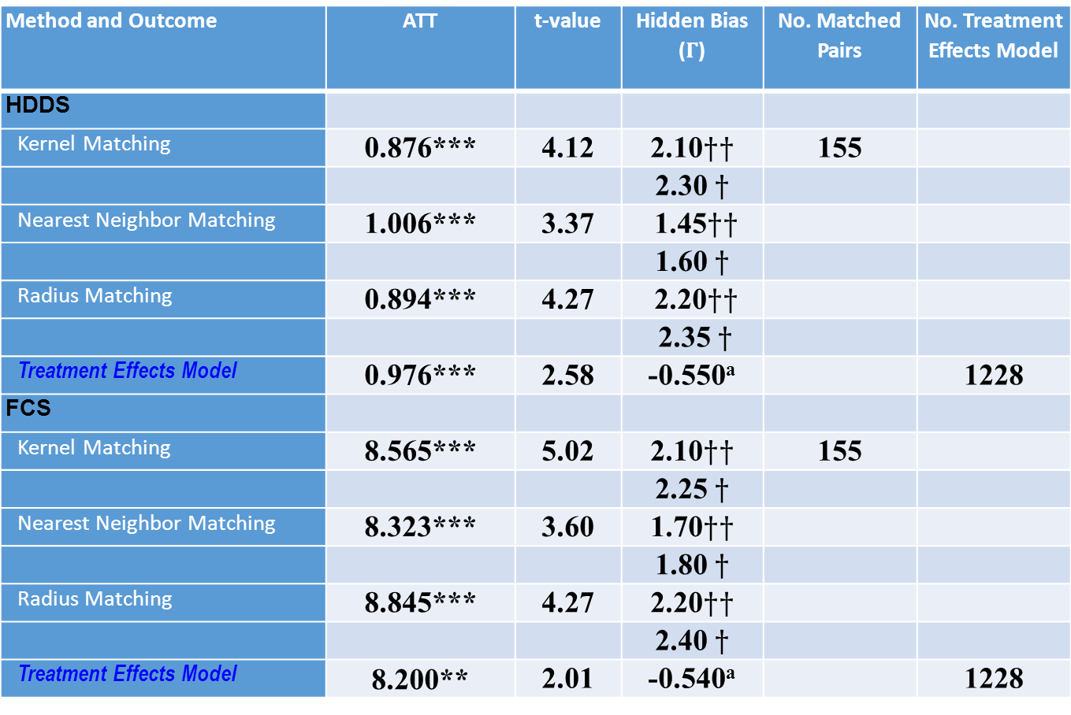
Table 2a: Impact of SACCOs on HH Welfare: Sample of 2010/2011
Method and Outcome | ATT | t-value |  | No. Matched Pairs | No. Treatment Effects Model
HDDS
Kernel Matching | 0.876*** | 4.12 |  | 155
Nearest Neighbor Matching | 1.006*** | 3.37
Radius Matching | 0.894*** | 4.27
Treatment Effects Model | 0.976*** | 2.58 | -0.550ª |  | 1228
FCS
Kernel Matching | 8.565*** | 5.02 |  | 155
Nearest Neighbor Matching | 8.323*** | 3.60
Radius Matching | 8.845*** | 4.27
Treatment Effects Model | 8.200** | 2.01 | -0.540ª |  | 1228
Note: ***,**,* indicate significance at 1%, 5%, and 10%, respectively. $††$ indicates the value of $Γ$ at 5% level of significance. $†$ indicates the value of $Γ$ at 10% level of significance. ª denotes the t-value for Lambda in the hazard function of the treatment effect model. Exchange Rate; US$1.00 = Shs 2,200

Slide 15
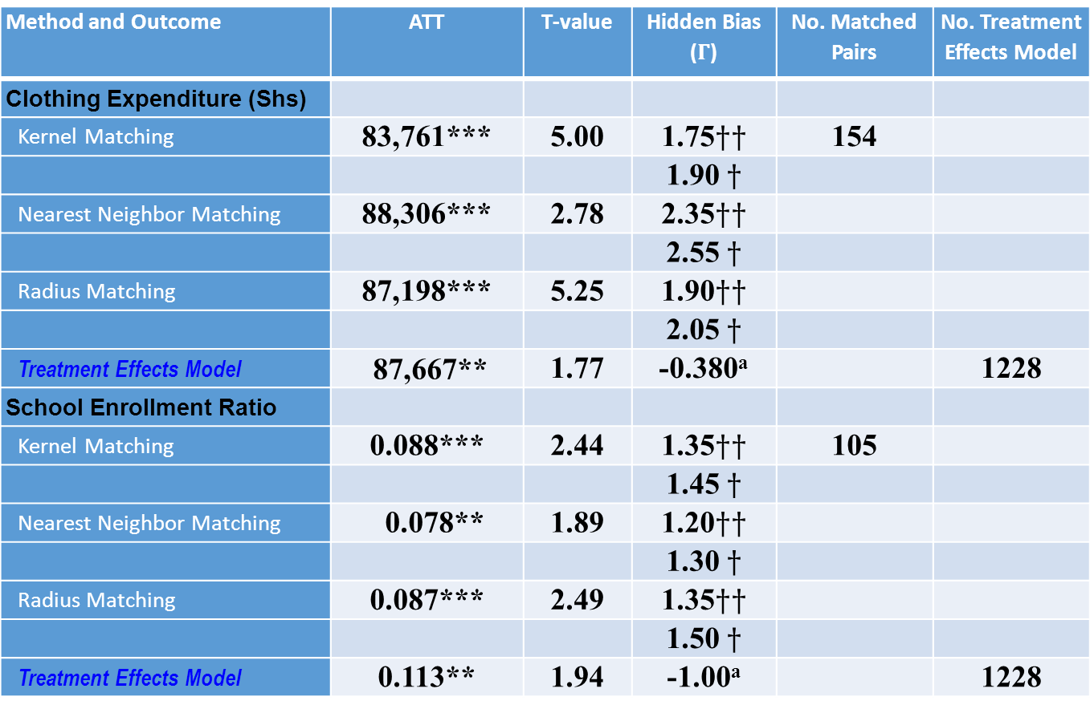
Table 2b: Impact of SACCOs on HH Welfare: Sample of 2010/2011
Method and Outcome | ATT | T-value |  | No. Matched Pairs | No. Treatment Effects Model
Clothing Expenditure (Shs)
Kernel Matching | 83,761*** | 5.00 |  | 154
Nearest Neighbor Matching | 88,306*** | 2.78
Radius Matching | 87,198*** | 5.25
Treatment Effects Model | 87,667** | 1.77 | -0.380ª |  | 1228
School Enrollment Ratio
Kernel Matching | 0.088*** | 2.44 |  | 105
Nearest Neighbor Matching | 0.078** | 1.89
Radius Matching | 0.087*** | 2.49
Treatment Effects Model | 0.113** | 1.94 | -1.00ª |  | 1228
Note: ***,**,* indicate significance at 1%, 5%, and 10%, respectively. $††$ indicates the value of $Γ$ at 5% level of significance. $†$ indicates the value of $Γ$ at 10% level of significance. ª denotes the t-value for Lambda in the hazard function of the treatment effect model. Exchange Rate; US$1.00 = Shs 2,200

Slide 16
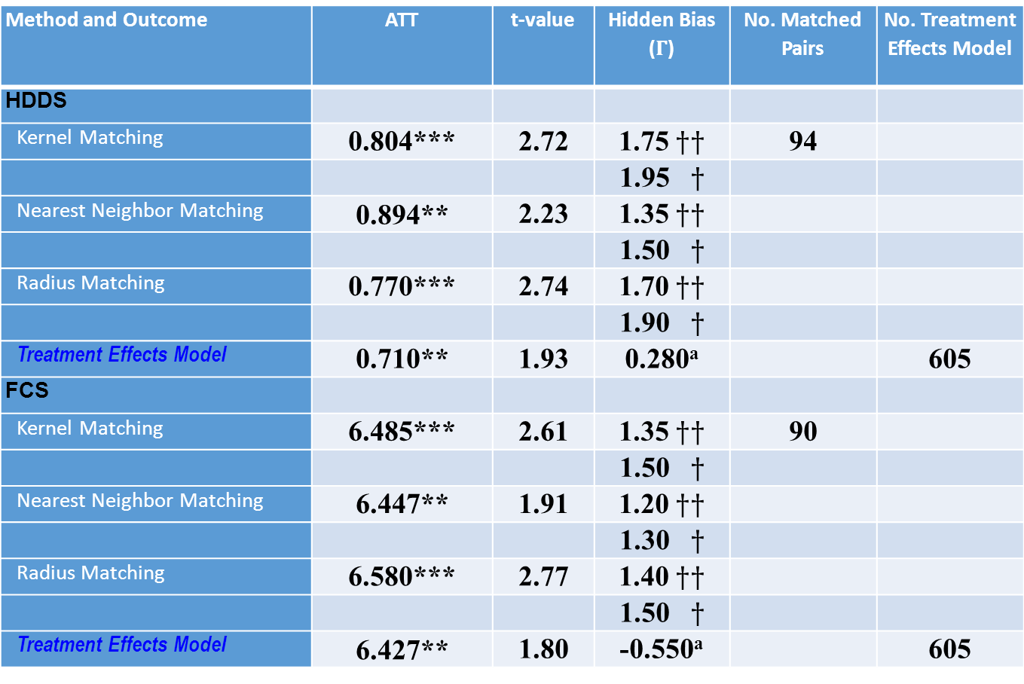
Table 3a: Impact of SACCOs on HH Welfare: Sample of 2009/2010
Method and Outcome | ATT | t-value | Hidden Bias ($Γ$) | No. Matched Pairs | No. Treatment Effects Model
HDDS
Kernel Matching | 0.804*** | 2.72 | 1.75 $††$ | 94
 |  |  | 1.95 $†$
Nearest Neighbor Matching | 0.894** | 2.23 | 1.35 $††$
 |  |  | 1.50 $†$
Radius Matching | 0.770*** | 2.74 | 1.70 $††$
 |  |  | 1.90 $†$
Treatment Effects Model | 0.710** | 1.93 | 0.280ª |  | 605
FCS
Kernel Matching | 6.485*** | 2.61 | 1.35 $††$ | 90
 |  |  | 1.50 $†$
Nearest Neighbor Matching | 6.447** | 1.91 | 1.20 $††$
 |  |  | 1.30 $†$
Radius Matching | 6.580*** | 2.77 | 1.40 $††$
 |  |  | 1.50 $†$
Treatment Effects Model | 6.427** | 1.80 | -0.550ª |  | 605
Note: ***,**,* indicate significance at 1%, 5%, and 10%, respectively. $††$ indicates the value of $Γ$ at 5% level of significance. $†$ indicates the value of $Γ$ at 10% level of significance. ª denotes the t-value for Lambda in the hazard function of the treatment effect model. Exchange Rate; US$1.00 = Shs 2,200

Slide 17
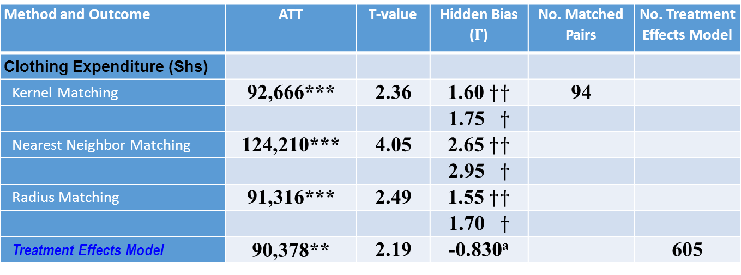
Table 3b: Impact of SACCOs on HHD Welfare: Sample of 2009/2010
Method and Outcome | ATT | T-value | Hidden Bias ($Γ$) | No. Matched Pairs | No. Treatment Effects Model
Clothing Expenditure (Shs)
Kernel Matching | 92,666*** | 2.36 | 1.60 $††$ | 94
 |  |  | 1.75 $†$
Nearest Neighbor Matching | 124,210*** | 4.05 | 2.65 $††$
 |  |  | 2.95 $†$
Radius Matching | 91,316*** | 2.49 | 1.55 $††$
 |  |  | 1.70 $†$
Treatment Effects Model | 90,378** | 2.19 | -0.830ª |  | 605
Note: ***,**,* indicate significance at 1%, 5%, and 10%, respectively. $††$ indicates the value of $Γ$ at 5% level of significance. $†$ indicates the value of $Γ$ at 10% level of significance. ª denotes the t-value for Lambda in the hazard function of the treatment effect model. Exchange Rate; US$1.00 = Shs 2,200

Slide 18
Table 4: Clothing & Footwear Expenditure: Matched HH Size Means
 | 2010/2011 Sample
Method | Non-SACCO HH Size | SACCO HH Size | p-value
Kernel Matching | 7.880 | 8.351 | 0.272
Nearest Neighbor Matching | 8.214 | 8.351 | 0.736
Radius Matching | 7.770 | 8.351 | 0.178
 | 2009/2010 Sample
Method | Non-SACCO HH Size | SACCO HH Size | p-value
Kernel Matching | 7.533 | 7.585 | 0.907
Nearest Neighbor Matching | 7.511 | 7.585 | 0.858
Radius Matching | 7.510 | 7.585 | 0.867

Slide 19
Table 5: HDDS Kernel Matching Results of Sample HH Characteristics
Variable Treated Control p-value
HH Income (Shs) 1,000,000 910,000 0.751
HH Head Age 45.62 44.81 0.576
HH Head Education 8.66 8.58 0.892
HH Head Work Exp 19.17 19.03 0.932
Location Dummy 0.245 0.239 0.905
HH Head Gender 0.813 0.802 0.815
Cooks with Firewood 0.800 0.801 0.989
Exchange Rate: US$1.00 = Shs 2,200
Location (Urban=1; Rural=0)
HH Head Gender (Male=l; Female=0)
Cooks with Firewood (Yes=1;No=0)

Slide 20
5.0 Conclusions
We use propensity score matching and two-step treatment effects models. Results are similar.
Tests show Confounding Factors Not a Serious Problem in our ATT estimations(Differences in Mean Outcomes).
SACCOs play key role in HH food security; clothing & footwear expenditure; school enrollment.
SACCOs important in poverty alleviation and don’t need substantial investment in physical & institutional infrastructure like that required by traditional microfinance organizations.
Many SACCOs face:(a) Poor financial management & capacity; (b)Poor bookkeeping; (c) Inadequately skilled staff and boards (BoU,MoFPED,2017).
Given SACCOs’ importance to vulnerable HHs, thus need for supervision of SACCOs thru Monetary Authorities to improve SACCO service provision.

