Slide 1
THE UDN’S CBMES MODEL: A PRACTICAL MULTI-LEVEL TOOL FOR TRANSFORMING M&E GLOBALLY .
Presented at the 7th Uganda Evaluation Week (UEW) under the theme
“From Evidence Generation to Utilization”.
Presented by Gilbert Musinguzi,
Quality Assurance Manager, Uganda Debt Network

Slide 2
M&E Misconceived & Therefore Peripherised
Monitoring and Evaluation (M&E) exists not just for the purpose of accountability but to serve the interest of intended beneficiaries of an intervention.
Experience has shown that (I dare say “erroneously”) M&E serves the single purpose of accountability, not internal but mainly external – to financiers of the intervention.
It is usually viewed internally as a bothersome academic requirement which eats into the time and resources that would have otherwise been allocated to programme delivery – “the core objective of the project”. As such, personnel responsible for M&E have a challenge of garnering cooperation from their peers, almost taking it personal.

Slide 3
M&E Function Highly Lacking at LGs
In a District Peer Review Mechanism Exercise conducted in districts of Katakwi, Amuria and Napak by Uganda Debt Network – UDN, it was found that Planning Departments in those districts did not have any budget to do M&E, and only fulfilled that obligation by piggy-banking on outreach programmes of other departments.
(Ref. Uganda Debt Network, 2017, District Peer Review Mechanism Exercise Report (Unpub).

Slide 4
Background about CBMES Implementation
UDN has a long history of Implementing CBMES model
The CBMES model is a practical M&E approach that involves beneficiaries, government officials and implementing agencies.
It is “a process through which communities measure the quantity and quality of public services and other government activities, not just simply to collect data about government’s performance, but to strengthen the relationship between citizens and the state.
It informs people about their entitlements, promises made to them by government and tools to ensure they receive both the entitlements and the promises.” (Ref: UDN, 2012, CBMES Manual)

Slide 5
CBMES appreciated & Adopted by others
While UDN was applying the approach and reporting on its relative efficacy to development partners (donors), some of the UDN donors appreciated the model and required their other partners to undergo a form of apprenticeship with UDN in application of CBMES, and as such they adapted it to their situations.
UDN has hitherto, on Donors requests, organised CBMES model based training to 27 organisations that were beneficiaries of Donors like Democratic Governance Facility, Trocaire Uganda, Dan Church Aid and PATH.
Results have been quite impressive – Examples of CSOs using it include ACCU, COU-TEDDO, SOCADIDO, ABH – PATH, etc.

Slide 6
Practical nature of CBMES Model – Beyond Usual M&E
While conventional M&E tend to be more theoretical and quite detached from the project beneficiaries, CBMES model brings M&E down to earth by involving grassroots community based resource persons to monitor, assess and report on programmes, and there after follow up for sanctions and rewards for implementers; Then celebrate success together on seeing changes
As such UDN has used CBMES Model for Capacity Building in M&E; and made direct target beneficiaries pivotal among practitioners.
While other aspects of M&E may have been deemed to gather dust, the application of learning and adaptation from CBMES tells a different narrative.

Slide 7
Relating the Model to the UEA Week
It is these results that we would like to anchor upon for the enrichment of the weeklong session of the 7th Uganda Evaluation Week (UEW) under the theme “From Evidence Generation to Utilization”.
Title of the presentation: The UDN’S CBMES MODEL: A practical multi-level tool for transforming M&E globally .
It is UDN’S CBMES Model” Because it was pioneered by UDN (not copyrighted yet).
Practical – relating to the theme “From Evidence Generation to Utilization”.
MULTI-LEVEL TOOL because its applied at community, Sub county, District, National and somehow at international level, hence Global

Slide 8
What is CBMES?
This is a creative and adaptive information system that is based primarily on the needs and interests of a given community.
A CBMES is a tool box that contains different methodologies which support the communities to realise their rights to participation in development process, opportunities, identify and find solutions to their problems, including challenging different levels of government to respond through amicable solutions

Slide 9
The CBMES process
A CBMES is meant to strengthen the beneficiaries’ self-esteem and build their power and clout to demand accountability as part of their daily routine. Service providers begin to see a more knowledgeable citizenry who can no longer be taken for granted.
Through the CBMES, men, women, boys and girls instead strive to improve their engagement with the state so that officials improve the delivery of their mandate with improved quality of public services. They positively re-orient their attitude towards poor and marginalized people and promote transparency and accountability, gender-sensitive, responsive and equitable development.
The CBMES process is a joint effort between insiders (the community) and the outsiders (CSOs - that usually play the role of facilitator, and local governments) that work together to ensure that the programmes, projects and activities planned by the central government and the local governments are relevant, transparent, accountable and reflect value for money in meeting the desired set goals and objectives.

Slide 10
Why CBMES?
It encourage pro-activeness about issues that affect them, that a Community Based Monitoring and Evaluation System (CBMES) is embedded. The CBMES, therefore, aims at:
Empowers communities through learning processes, skills and knowledge formation that enables them to articulate their development agenda.
Mobilizing communities to participate fully and effectively in identifying and monitoring the quality delivery of services by government agencies.

Slide 11
Why CBMES? Cont’d
It seeks to involve the people (Men & Women) at the grassroots to measure the performance of government agencies, the relevance of their programmes and impact to poverty reduction
Providing the knowledge and skills to poor people (Men & Women) and the citizens in the community to track and monitor government decision-making.
Involving grassroots people in decision-making; broad participation, building consensus with various stakeholders (Men & Women) and having their voices incorporated into the policy process.
Building the capacity of the grassroots to engage the policy planners at all levels (local, national and international).

Slide 12
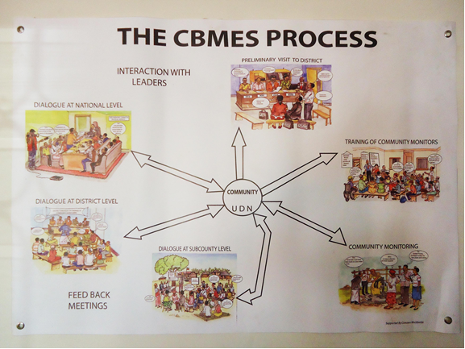

Slide 13
CBMES – A Citizen Centered Governance Model
UDN has been implementing CBMES as a tool to impart monitoring and evaluation skills among grassroots-based communities in various districts to enable them monitor and evaluate the implementation of government programmes in their localities.
This process has been part of a wider bid to contribute to the development of democracy through promotion of citizens’ participation in shaping public affairs that concern them.
CBMES was instrumental in creating civic awareness, was simple to operate and propelled by popular community initiatives and concerns, easy to replicate and credible in bringing service users and providers to interface, dialogue and agree on common and amicable positions in the delivery of public goods and services.

Slide 14
A Brief History of the Model
UDN pioneered citizens’ mobilization, conscientization and participation in public affairs, through the Periodic Monitoring Committees (PMCs) in the 2000. Due the limitations of PMCs, such as carrying out monitoring only periodically and involving very few members of a community, a better approach was engineered. This was the CBMES
CBMES ensured that government programmes and processes took into consideration the interests of the ordinary citizens. Indeed, CBMES succeeded in mass mobilization and promotion of citizens’ vigilance to challenge service providers (government institutions, contractors and public servants), for effective delivery of public goods and services of high quality and quantity to the intended beneficiaries.

Slide 15
AIMS OF THE CBMES MODEL
Empowering communities through learning processes, skills and knowledge formation that enable them to articulate their development agenda;
Mobilizing communities to participate fully and effectively in identifying and monitoring the quality of delivery of services by government agencies. It seeks to involve the people at grassroots to measure the performance of government agencies, the relevance of their programmes and impact to poverty eradication;
Providing the knowledge and skills to the community to track and monitor government decision-making;
Involving grassroots people in decision-making; broad participation, building consensus with various stakeholders and having their voices incorporated into the policy process;
Building the capacity of the grassroots to engage the policy planners at all levels (local, national and international).

Slide 16
Sequential Phases Through Which The Model Is Applied / Executed
Phase one: involves carrying out situation analysis and preliminary assessments in order to establish defects in service delivery in a District. UDN organises introductory meetings with the District authorities prior to establishment of the CBMES structures.
Phase two involves mobilisation and identification of CBMs that UDN will work with.
Phase three involves capacity building trainings for the identified CBMs on the basics, procedures and methods of conducting service delivery monitoring including orientation on their roles and responsibilities. Monitoring tools are also collectively developed; practical field pre-test of the tools developed in and practice of report writing using the data collected during the field pre-test.
Phase four involves actual organisation of advocacy and lobbying events.

Slide 17
Advocacy And Lobbying Events (AKA Public Dialogues) Happen At different levels
CBMs are facilitated to organize a feedback meeting at the sub-county level supported to present their findings to duty bearers.
The meeting is attended by representatives of the various communities from different parishes, Local Government officials and service providers.
After the sub county dialogue(s) another meeting is organized at the district to disseminate the findings and generate action on key issues raised in the reports.
The meeting is attended by community representatives from the Sub County or sub counties including where monitoring has been done. The district dialogue meeting is attended by Local Government officials, the district political leaders, media etc.
The national dialogue meeting is attended by line ministries; a comprehensive report is usually compiled from the reports from the different districts. At the national level, UDNs role is more imperative.

Slide 18
CBMES Summary - Advocacy & Lobbying framework
Level | Activities | Outputs
National | Meeting with stakeholders like the ministries, donors, parliamentarians, media etc to discuss the findings. Taking note of the commitments made. Feed back to the community monitors and community members. | Issues raised are for follow up Media coverage.
District | Districts dialogues Pulling out of critical issues to be submitted to the line ministries, MoFED, OPM, MoLG and other policy makers for discussion and follow up Taking note of the commitments made to the community members on the issues raised. Follow up meetings with the district officials on the commitment made. Feed back to the community members at the sub counties | Increased interaction with district leaders Compilation of national report. Number of commitments made Media coverage
Sub-county | Sub county dialogues Compilation of district dialogues report on issues beyond the jurisdiction of the sub county Noting of the commitments made to the community members Follow up on the commitment made Feedback to the community members | Su county reports Action plans Interaction with sub county leaders Number of commitments made. Media coverage
Community | Developing monitoring indicators Monitoring activities in the different government programmes Analysis of findings and report writing Final report for presentation at sub county dialogue. | Formation of structures Monitoring tool depending of the government programme to be monitored Reports for the sub county dialogues.

Slide 19
“From Evidence Generation to Utilization”.
In 2016 Under the auspices of Dan Church Aid, the efficacy of UDN’s CBMES Model was tested through an evaluation (Evaluation of the CBMES Model Review and results were telling.
The exercise focussed on evidences of CBMES impact in the sectors of health, education, roads, and NAADS under Agriculture.
The study also sought to assess sustainability strategies of its benefits
Methodology: Comparison Communities with and those without CBMES

Slide 20
General Purpose of the Study
CBMES has served as a Tool for Building Civic competence and Community Participation in Decision Making Processes
interrogated the extent to which the CBMES approach successfully built the competence of communities to participate in decision making processes
Civic Competence between Communities with and without the CBMES Approach:

Slide 21
Objectives of the CBMES Evaluation exercise
The study aimed at establishing the impact approach in:
Building the civic competence of communities to effectively participate in decision making processes; and promotion of demand driven accountability (Citizen Voice).
Addressing resource mismanagement, corruption and leakages.
Improving access and quality of public service delivery.
Change stories (most significant changes) indicating the processes that were taken to realize the change.
Learning: The pitfalls, potentials and strategies improving the model

Slide 22
Under health services, there was observable contribution CBMES
CBMs influenced the following:
staffing levels,
infrastructure improvements (construction of maternity wards and staff houses),
supply and replenishment of essential drugs,
reducing theft of drugs, positive change in conduct of health facility staff,
reduced absenteeism among staff,
improved functionality of Health Unit Management Committees (HUMCs) and
community demands to upgrade of some health facilities from grade II to grade III due to increased population of users and demand for certain services out of the mandate of some of the health centres considering their levels.
(See Examples in Word Version of Report)

Slide 23
Success Stories
Rakai District, at Kalere HCII, communities mobilized and approached the DHO demanding for immediate posting of a midwife and it was done in one month:
Amuria District, at Acowa HCIII, communities wrote to the CAOs office demanding for immediate posting of 1 clinical officer, 1 midwife, 1 nurse, and 1 lab technician;
Amuria District, Asamuk HCIII, CBMs ensured OPD was constructed.
Napak District, Naweikoro HCII had 2 staff only since it was opened, but communities mobilized and approached Ngoleriat S/C chief over the issue and four more staff were posted including a midwife;
Moroto District, Nadunget HCIV had 6 medical staff for quite some time, but CBMs and community advocated for more stff and now it has 13 medical personel.

Slide 24
Success Stories Cont’d
Moroto District, Nadunget HCIV, communities demanded for construction of a theatre, an OPD, and staff house and was effected;
Katakwi District, at Amodoi HCII, the communities demanded for construction of a maternity ward and is under construction scheduled for completion in December 2016;
Moroto District, Nadunget HCIV, CBMs closely work with HUMCs to ensure that the drug stalk taking is done periodically to corss-check what is in the stores and what has been used from records;
Katakwi Distrcts, two health workers were interdicted because of theft of drugs through the “whistle-blowing from CBMs and it has scared the rest;
Napak District, CBMs work closely with the office of the DISO to keep checking the drugs availability and stock-outs, this have reduced the issue stock-outs and drug theft for fear of arrest by the security organs.

Slide 25
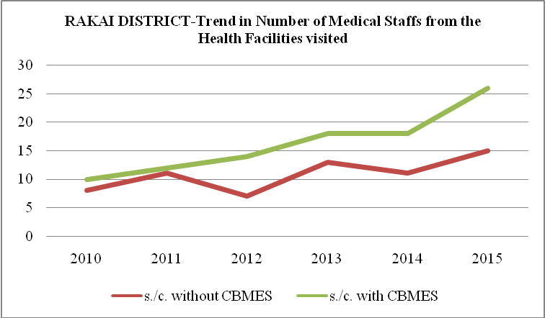
Rakai – Medics accommodation

Slide 26
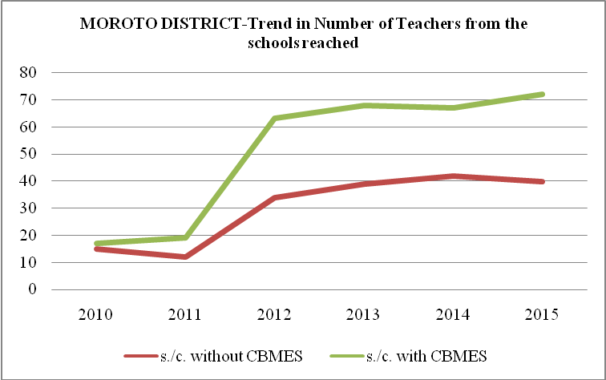
Moroto: School Staffing

Slide 27
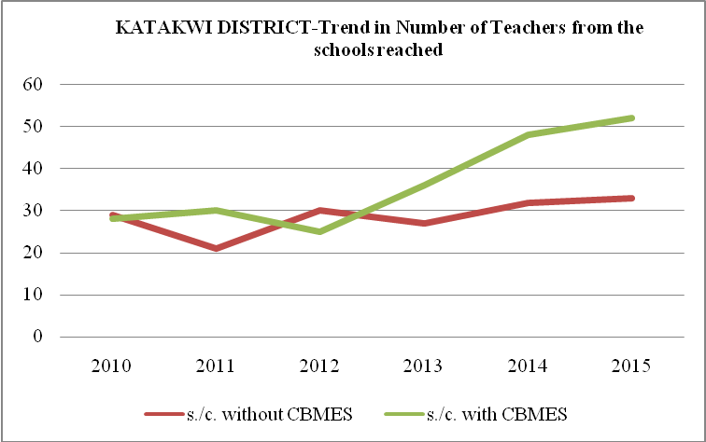
Katakwi: Teachers

Slide 28
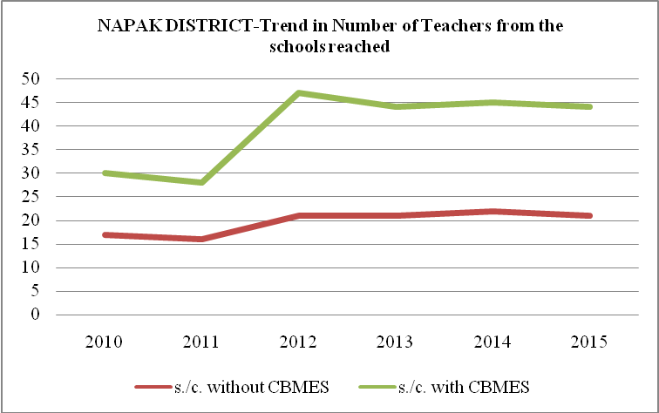
Napak: Schhol Staffing

Slide 30
Challenges associated with CBMES
Documentation – little evidence in most departments.
Education and Health are quite ahead of other depts.
Study Noted that CBMs need to focus on documentary evidence as well – not just service delivery
The model focused more on service delivery and left out a key element – evidence based
UDN itself needed to progressively document the efficacy of CBMES Model; Currently there is a document called Institutional Memory
Memory Lane document focuses more on the institution than programmes

Slide 31
Conclusions & Recommendations
The CBMES Model has shortcomings, especially relating to use of Volunteers; they get volunteer fatigue and when resources are lacking UDN provides other forms of motivation (eg Use of VSLA trainings, leadership skills that has made CBMs leaders – LCs, MPs, etc)
The model need to be improved – especially on documentation of its successes; and possibly integrated with other accountability models
M&E needs to be practical so that its benefits are profiled to make it a popular function in organizations and Government at all levels
Thanks

